Slide 1
Update on the National Inventory Collaborative: Focus on Model Performance
September 17, 2020

Slide 2
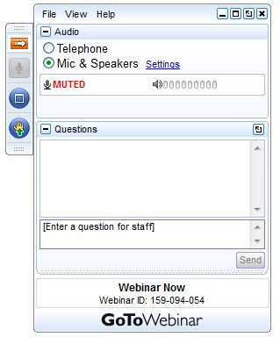
Webinar Ground Rules: Questions?
Each workgroup will give a ~5 minute update describing their work on the 2016v1 platform.
All call participants will remain on mute during the webinar.
Type your questions into the question box on the webinar client.
We will try to answer questions at the end of the webinar.
We will create a Q&A document following the webinar and post with the meeting notes on the Collaborative Wiki: http://views.cira.colostate.edu/wiki/wiki/9169

Slide 3
Agenda for Today
Introduction and Data Distribution Updates
Welcome and introduction (Zac Adelman)
IWDW Update - Platform status and summary of requests (Shawn McClure)
Data updates and Known Issues (Alison Eyth)
Model Performance Evaluation Workgroup Presentations
Introduction to the MPE workgroups (Heather Simon)
High Ozone Events in Maintenance/Nonattainment Areas (Kiernan Wholean)
Impact of Mobile Emissions Uncertainty on AQM Performance (Gil Grodzinsky)
Long Range Smoke Impacts on AQM Performance (Mat Hollinger)
Impact of Model Bias on Model Projections and Contributions (Byeong Kim)
2016v1 presentations on recent modeling and results
NYS DEC: CMAQ modeling comparisons between using EPA & IPM and
ERTAC EGU options and the preliminary 2023 DVF (Jeongran Yun)
LADCO: CAMx MPE Results in the Great Lakes Region: Ozone precursors (Zac Adelman)
EPA: Modeling Performance Evaluation and Sensitivity Overview (Heather Simon)

Slide 4
Intermountain West Data Warehouse (IWDW) Update
Shawn McClure, CIRA

Slide 5
NEIC 2016 Data - Intermountain West Data Warehouse (IWDW)
Getting to the IWDW…
Web address: https://views.cira.colostate.edu/iwdw/
Google search terms: “iwdw”, “intermountain data warehouse”, “wrap data warehouse”
Registering and logging in…
Registration page: https://views.cira.colostate.edu/iwdw/Auth/Register.aspx
Required info: Name, email address, organization, state
Finding NEIC 2016 data and metadata…
NEIC platform information (https://views.cira.colostate.edu/iwdw/Modeling/Platforms.aspx)
Download NEIC 2016v1 (https://views.cira.colostate.edu/iwdw/RequestData/Default.aspx?pid=NEIC_2016_V1)
NEIC 2016 Wiki (https://views.cira.colostate.edu/wiki/wiki/9169)

Slide 6
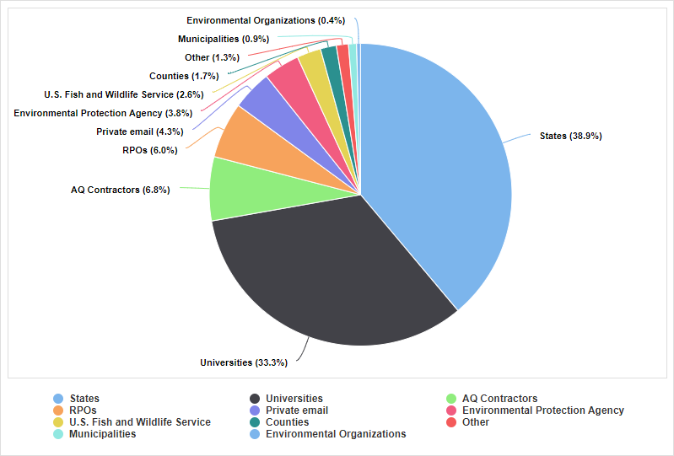
NEIC 2016 Data Requests – Organizational Composition
Type of Organization | Requests
States | 91
Universities | 78
AQ Contractors | 16
RPOs | 14
Private email | 10
Environmental Protection Agency | 9
U.S. Fish and Wildlife Service | 6
Counties | 4
Other | 3
Municipalities | 2
Environmental Organizations | 1

Slide 7
NEIC 2016 Data Requests – Component Downloads by “Popularity”
Name | Requests
2016 Premerged gridded emissions | 83
Annual Initial Conditions (ICs) and Boundary Conditions (BCs) | 61
2016 Emissions Inventories | 59
Emissions Processing Tools | 50
Ancillary Emissions Data | 46
BEIS biogenic model landuse input files | 41
CMAQ-ready gridded emissions inputs | 40
CAMx-ready gridded emissions inputs | 30
CAMx-ready WRF data | 29
MOVES Emissions Factors | 23
CMAQ-ready MCIP data | 21
WRF Output Data | 18
CMAQ Output – Concentrations | 14
CAMx-ready Ozone Column and Photolysis Rates | 13
CAMx Output – Concentrations | 13
2016 MEGAN biogenic emissions | 13
AMET Site-Compare Files | 13
CMAQ-ready Inputs for Dust Calculations | 10

Slide 8
Data Updates and Known Issues
Alison Eyth, EPA OAQPS

Slide 9
2016v1 Data Upgrades and Known Issues
A Wiki page is available from the 2016v1 platform release page that lists data updates and known issues
  Data+README are available: ftp://newftp.epa.gov/air/emismod/2016/v1/postv1_updates/
Data upgrades since October 2019 release
  Airport emissions were corrected after an overestimation in 2017NEI was discovered (June 2020)
  WRAP oil and gas data SMOKE inputs and scripts released on IWDW (April 2020)
  Commercial Marine Vessel (CMV) updates incorporated into release (February 2020)
  Updated IPM projection available from January 2020 (including flat files)
Known Issues
  2016 EGU emissions: some SO₂ and NO_{x} CEMS data at specific units were dropped by SMOKE during processing when one NEI unit mapped to multiple CEMS units (July, 2020)
  2023 and 2028 EGU emissions: some pseudo CEMS data at specific days/times/locations were dropped by SMOKE when heat input and other variables were equal to zero (June, 2020)
  Emissions missing from Soberanes fire on July 26, 2016
Coming soon: ERTAC base and future year inventories
Data summaries available: ftp://newftp.epa.gov/air/emismod/2016/v1/reports/
Notes:
More data summaries are added over time

Slide 10
Model Performance Evaluation Workgroup Reports
Introduction by Heather Simon, EPA OAQPS

Slide 11
EPA-State 2016 Modeling Platform Evaluation Forum
Goals
  focus was on modeling performed using the 2016 beta emissions
  promote collaboration between EPA and state/local partners on characterizing model performance
  serve as a venue for sharing data and evaluation results
    Data shared from 2016 beta model simulations inputs/outputs through IWDW and EPA sharepoint site
    Several hundred thousand model evaluation plots shared through LADCO site
Structure
  Monthly large group meetings
  Workgroups
    Model bias + response to emissions changes (Byoeng Kim – GA DNR)
    Boundary Layer Dynamics
    Impact of mobile emissions uncertainty on model performance (Gil Grodzinsky - GA DNR)
    Long range smoke impacts on model performance (Mat Hollinger- IDEM)
    Mode performance differences by site types
    Model performance focusing on high ozone events in maintenance/nonattainment areas (Kiernan Wholean - CT)
    N deposition
    Coastal ozone

Slide 12
Workgroup Summary:
High Ozone Events in Maintenance/Nonattainment Areas
Kiernan Wholean, CT DEEP

Slide 13
Presentations Available on Wiki Page
Weight of Evidence Analyses
Denver Area Moderate Ozone SIP (2017)
  –Amanda Brimmer/RAQC
Comparing CMAQ and CAMx Ozone Estimates to CT AQS Data
–Carmen Lamancusa/CT DEEP
Climate Regions: Northwest & West
Model Performance Focusing on High Ozone Events in
Maintenance/Nonattainment Areas
-Tes Ghidey/WDOE
Model Performance at Connecticut Ozone Monitors Categorized by Meteorological Regime
–Amanda Fritz/CT DEEP

Slide 14
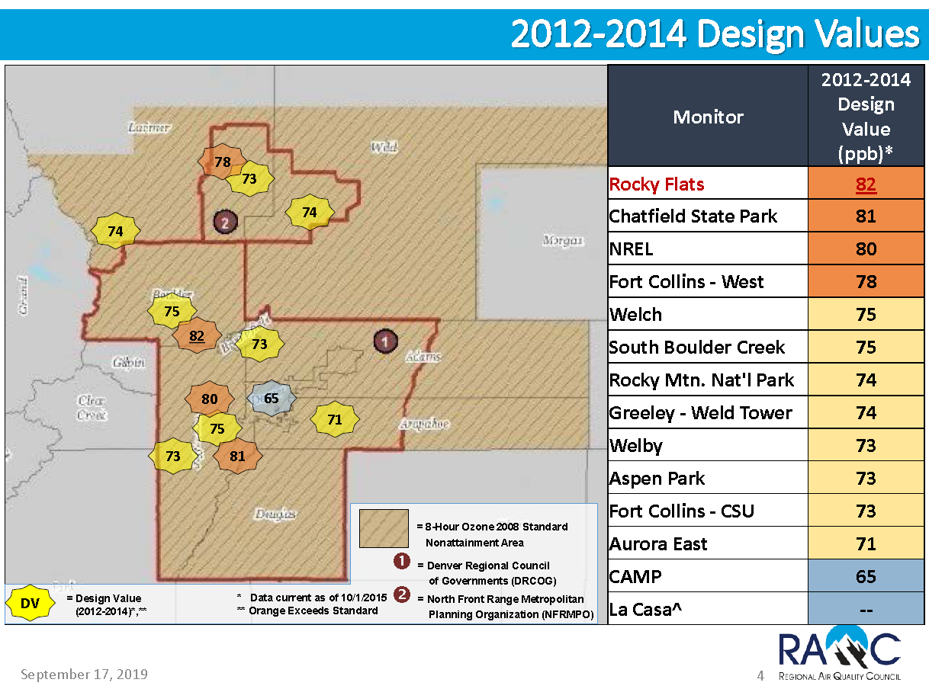

Slide 15
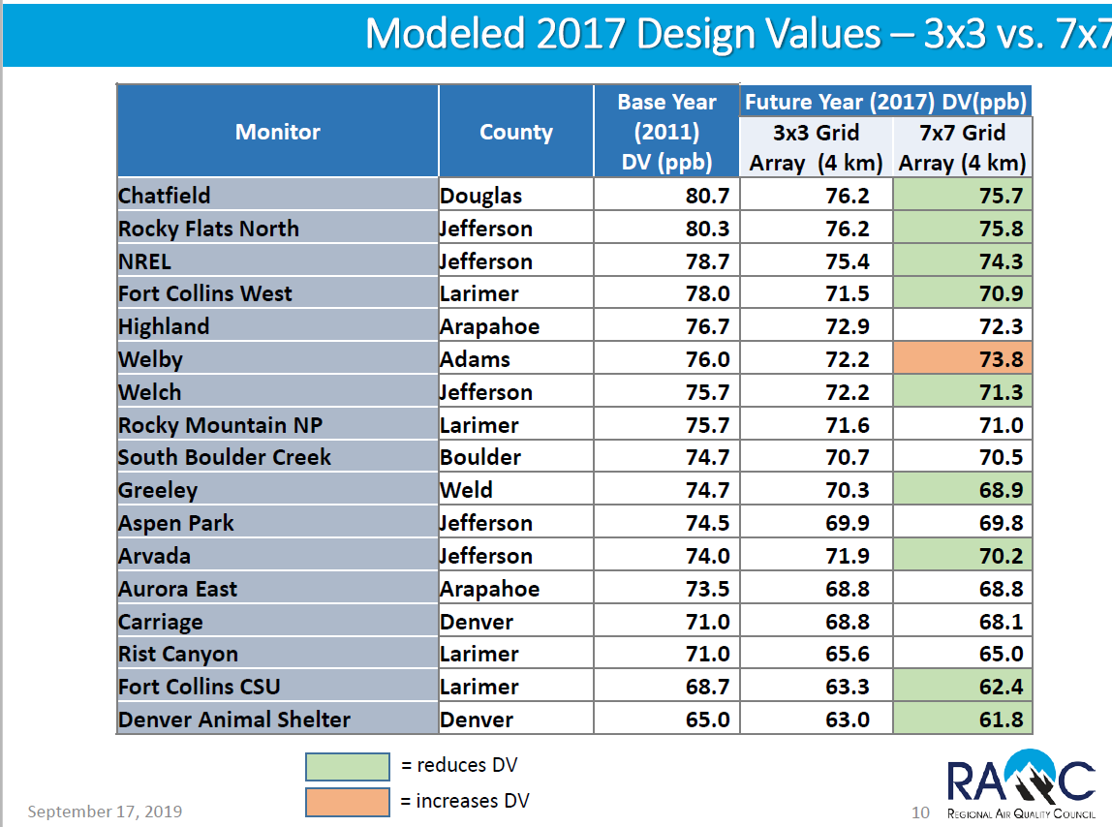

Slide 16
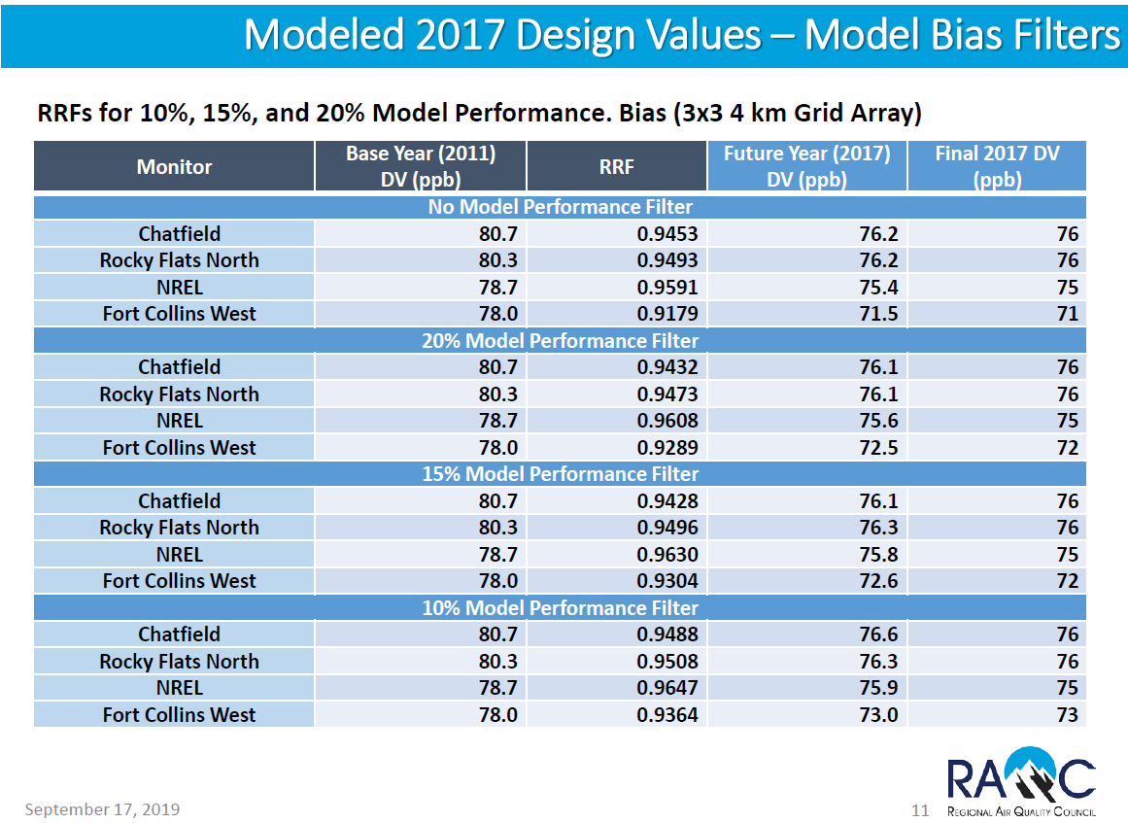

Slide 17
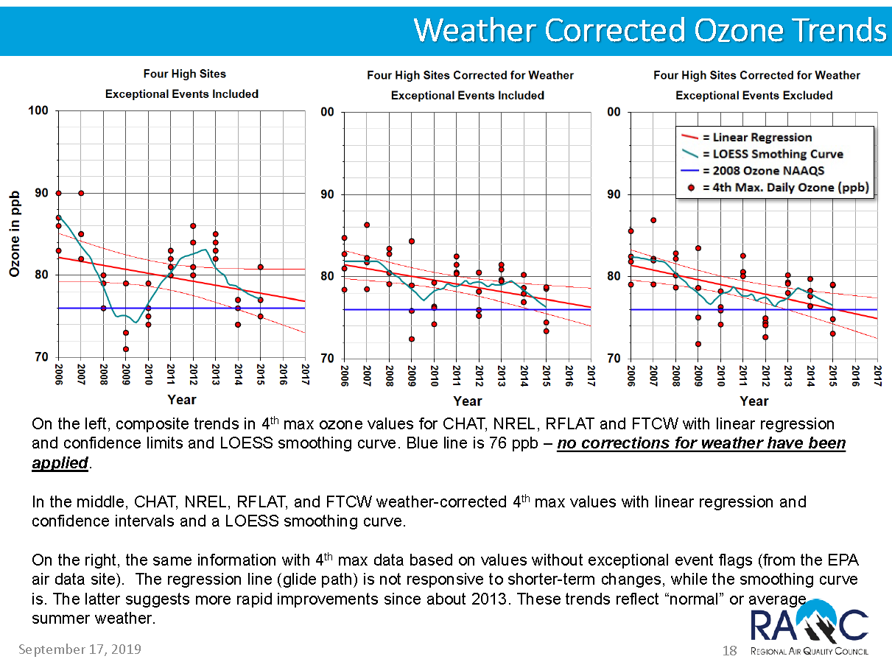

Slide 18
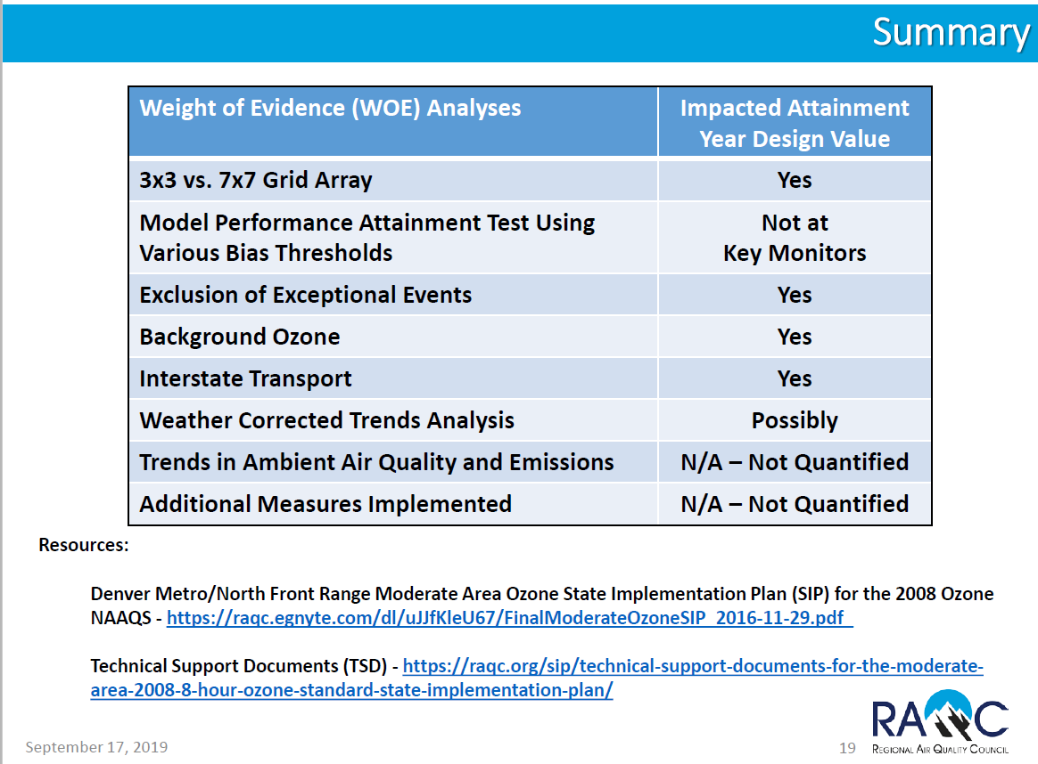

Slide 19
Air Monitors
Ozone Monitors
Coastal Ozone Monitors
Map of ozone monitors in Connecticut and its bordering states.

Slide 20
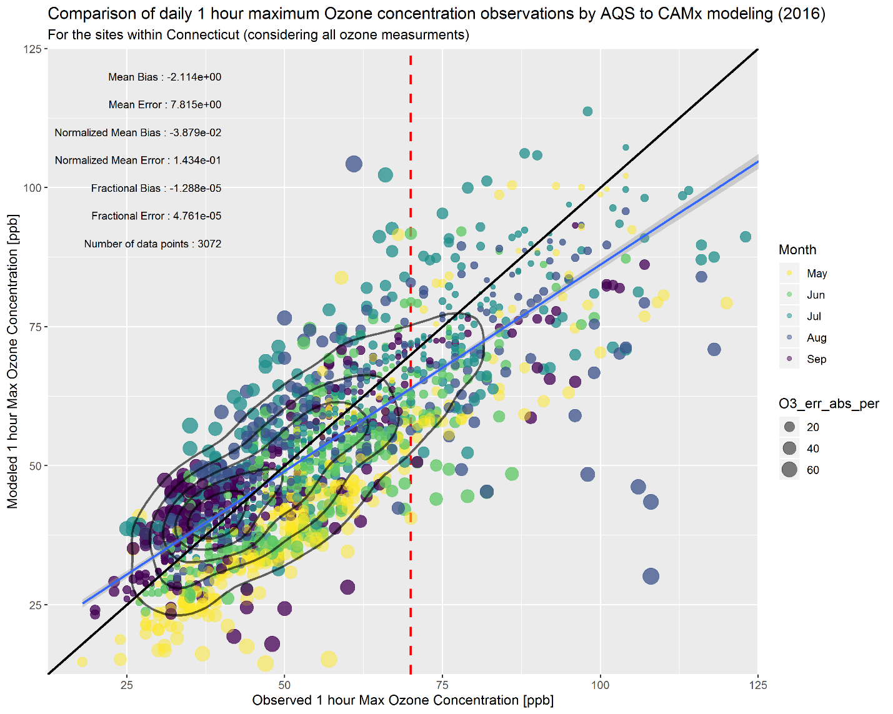
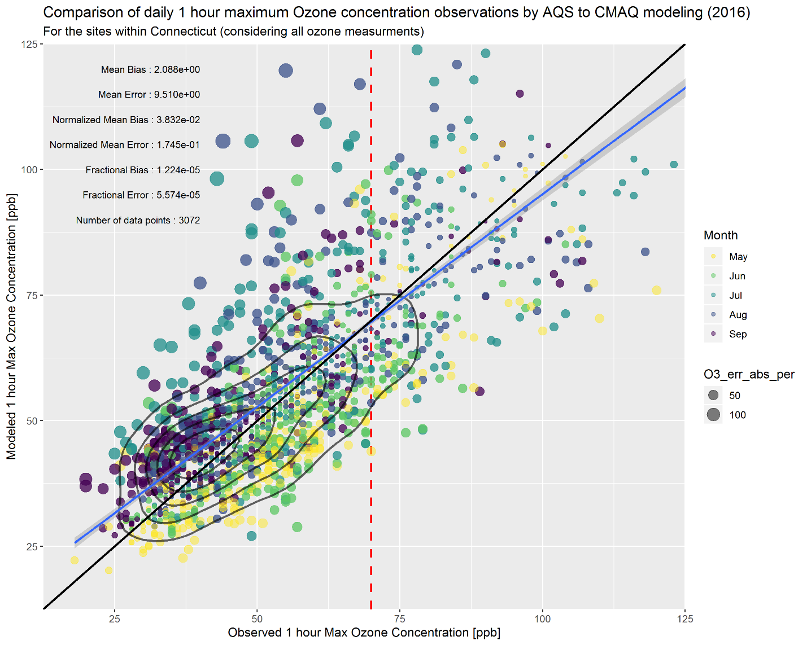
Statewide Comparisons
CAMx
CMAQ

Slide 21
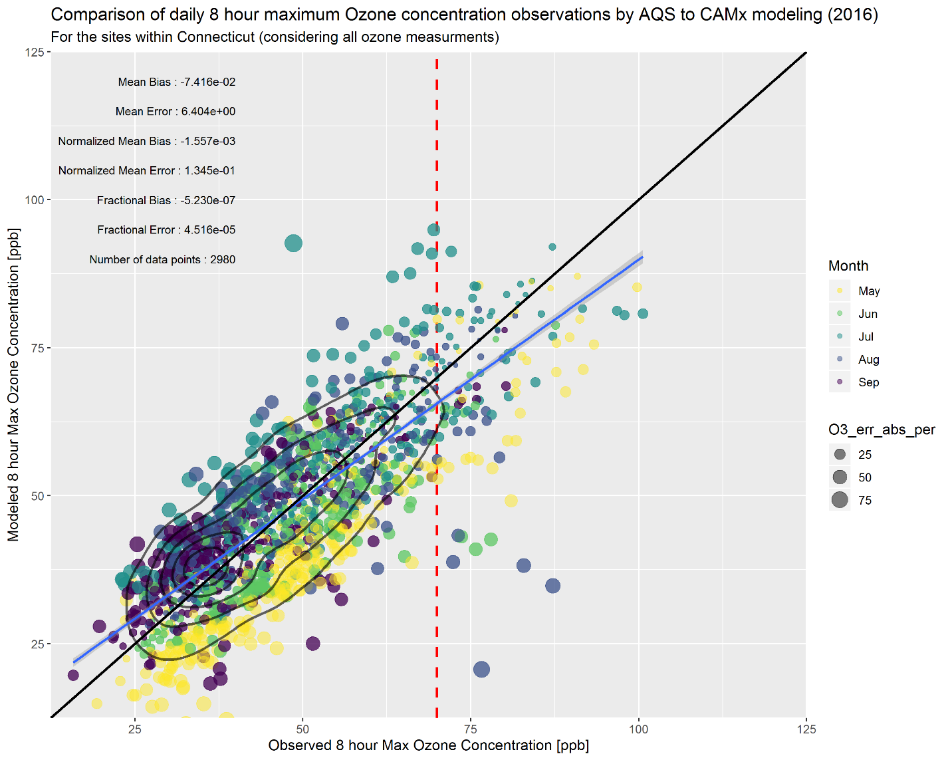
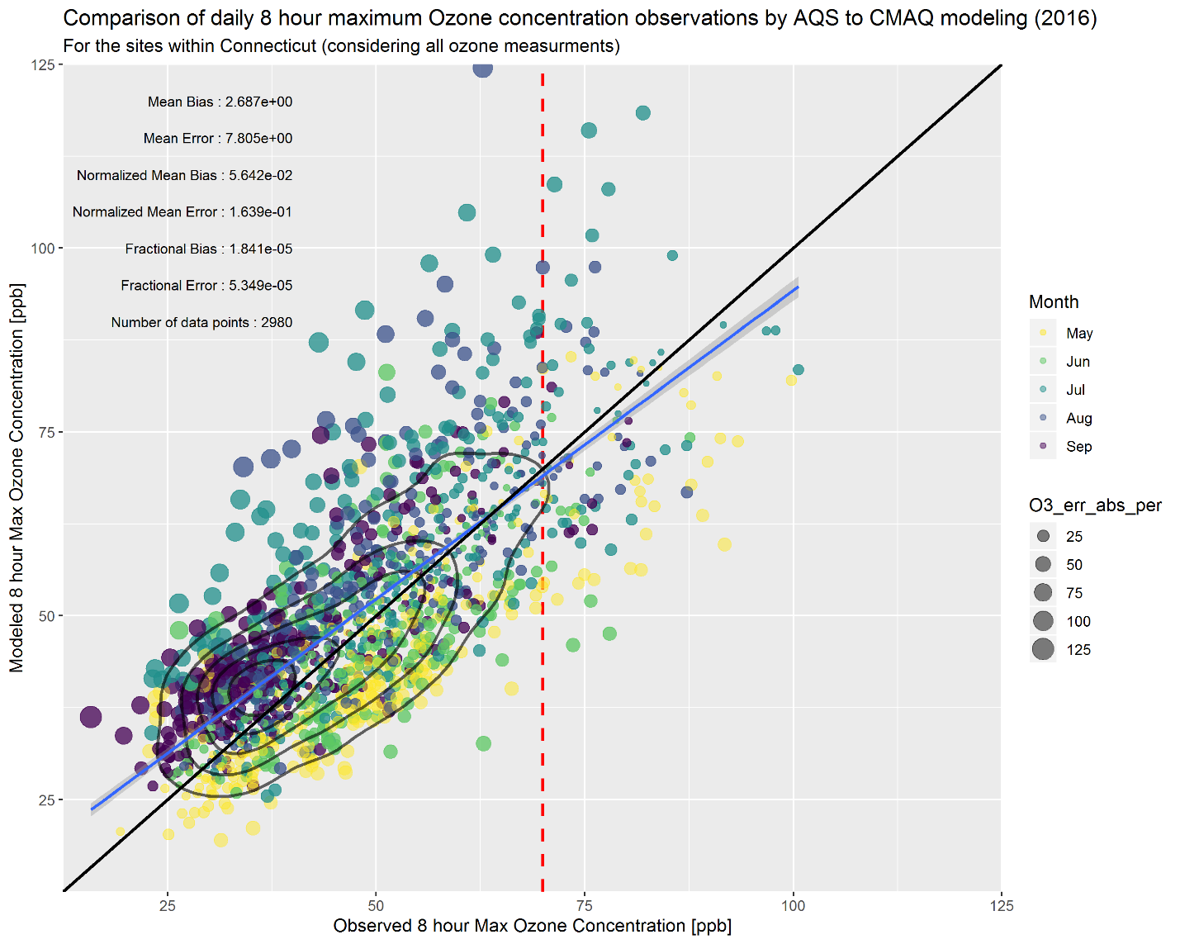
Statewide Comparisons (8 hour max)
CAMx
CMAQ

Slide 22
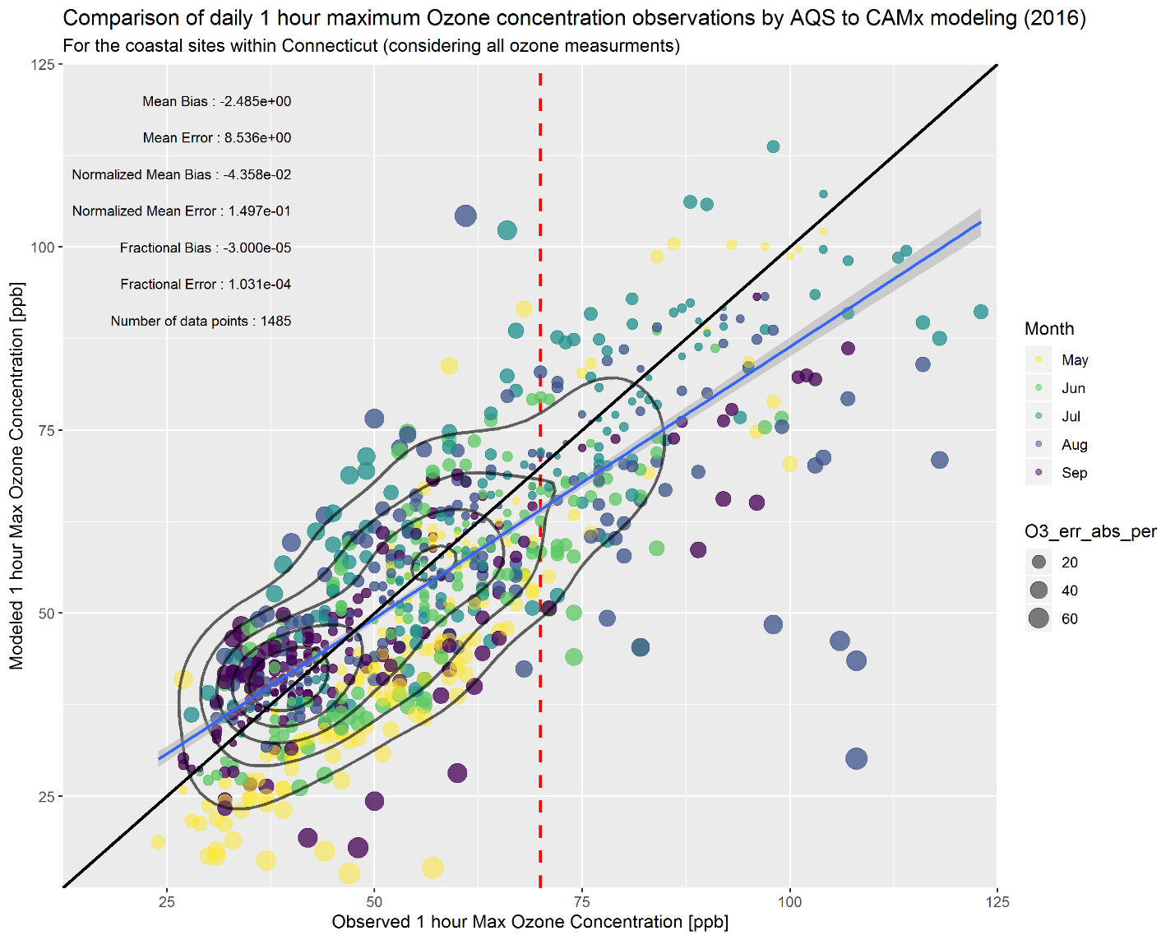
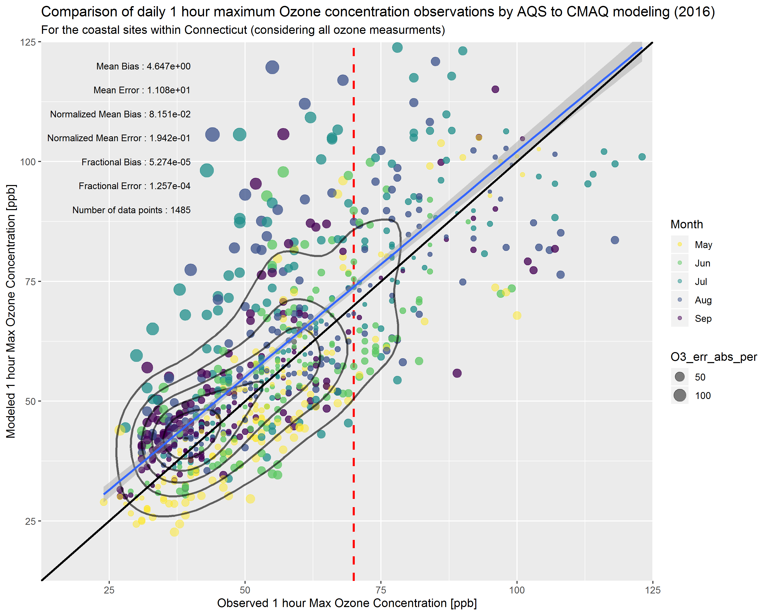
Coastal Comparisons
CAMx
CMAQ

Slide 23
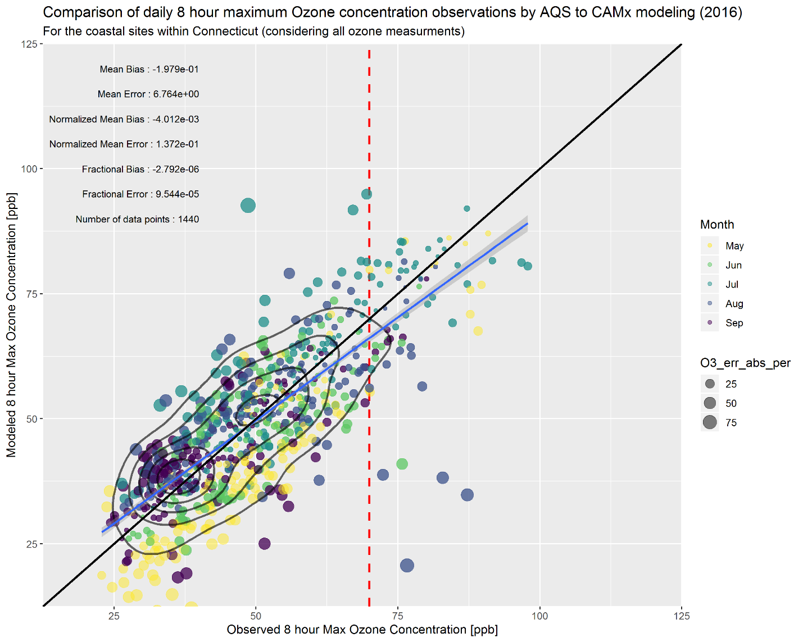
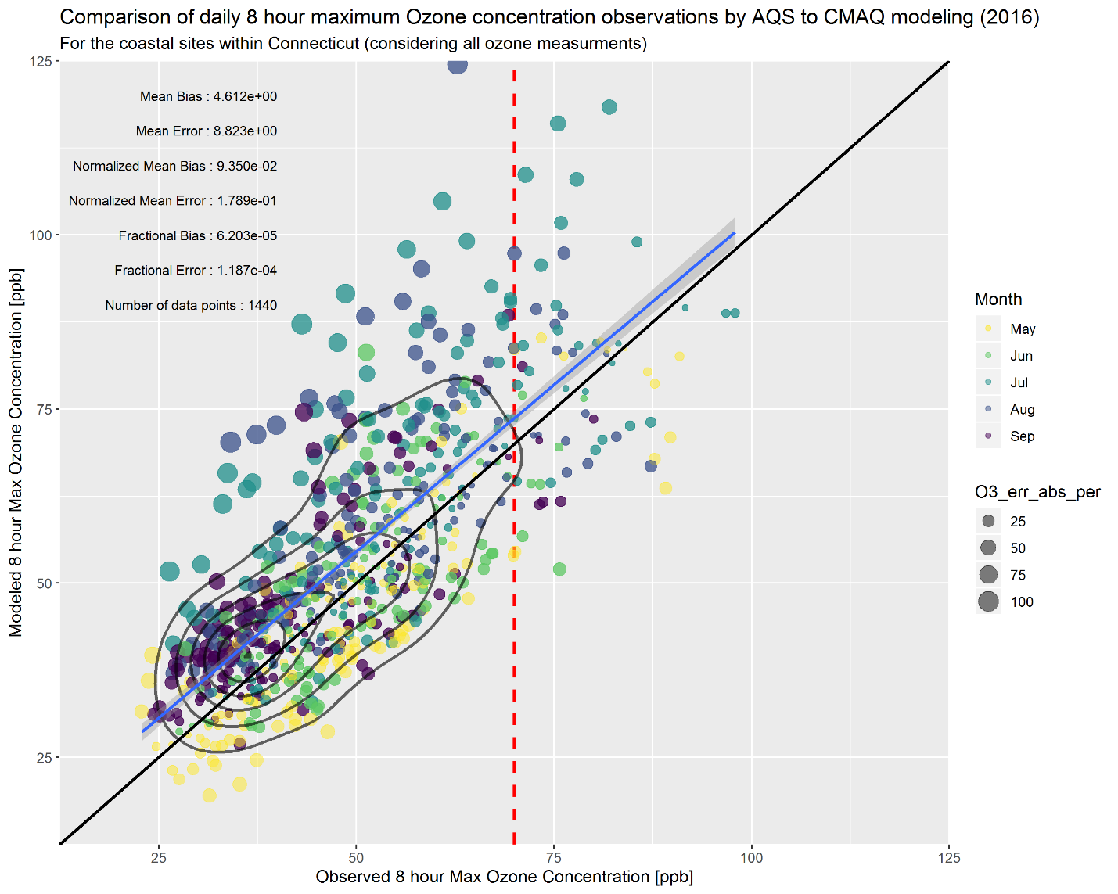
Coastal Comparisons (8 hour max)
CAMx
CMAQ

Slide 24
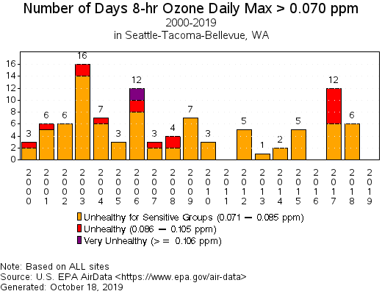
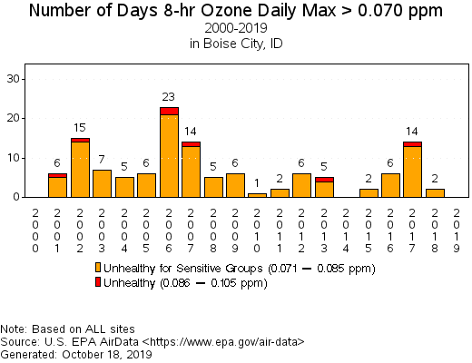
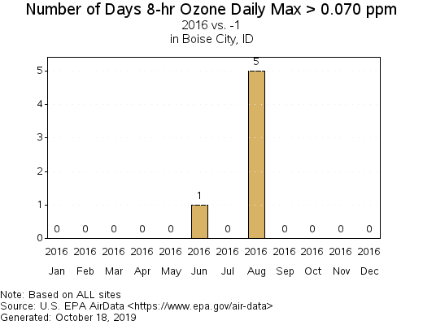
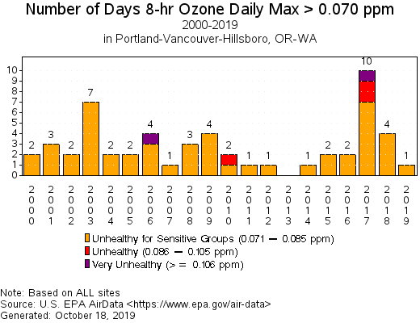
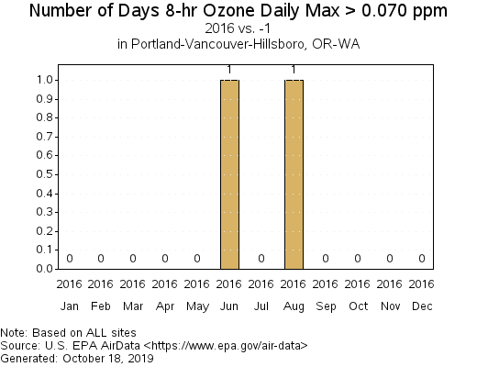
EPA Air Monitoring Data: Northwest region
WA
ID
*The Ozone season is generally defined by time period from May to Sep (5 months).
OR

Slide 25
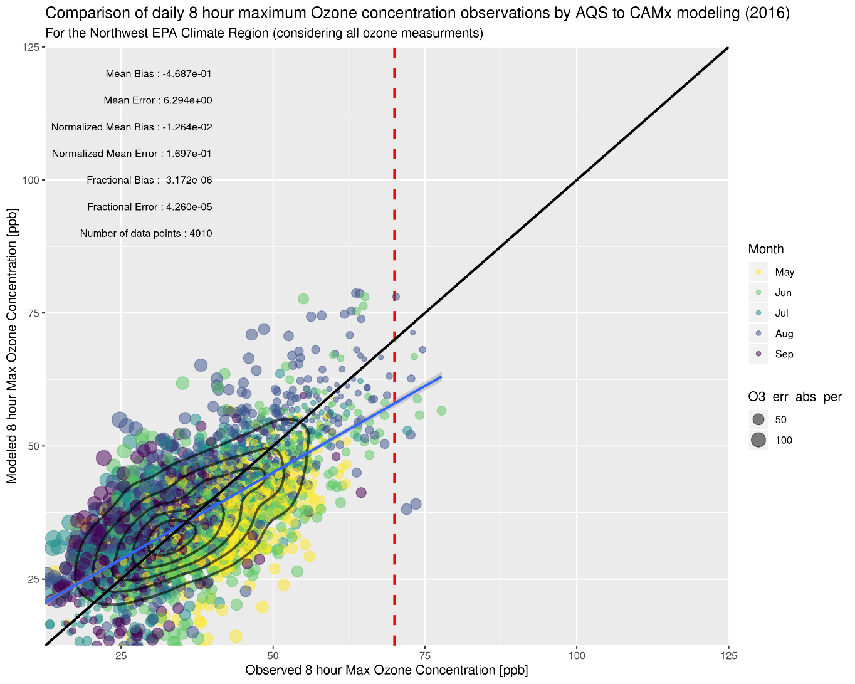
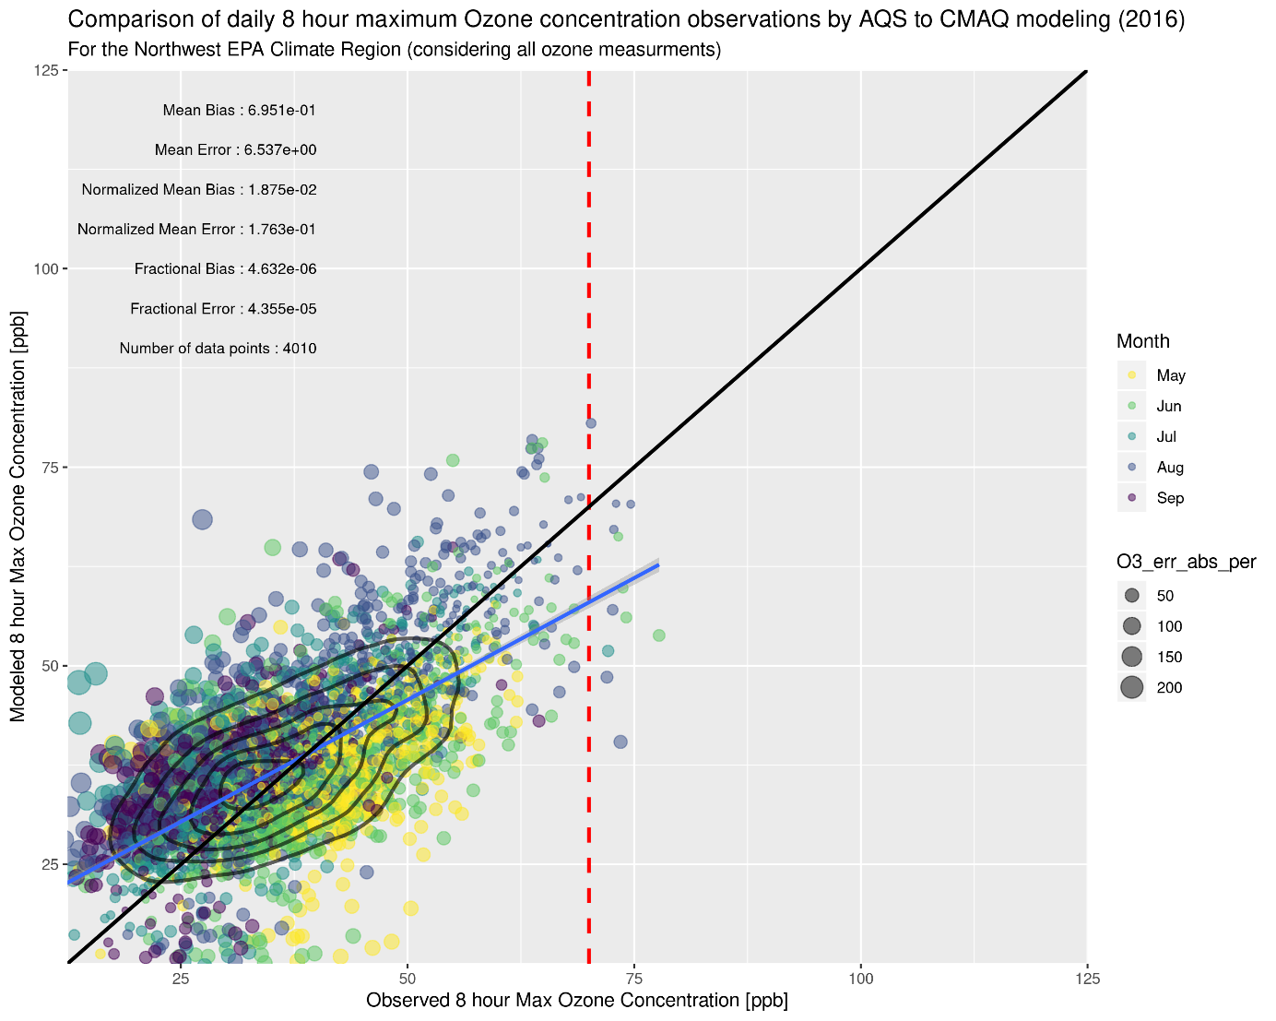
MDA8 Ozone Scatter Plot by Region/Season: Northwest
CAMx
CMAQ

Slide 26
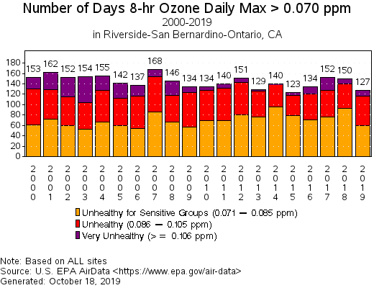
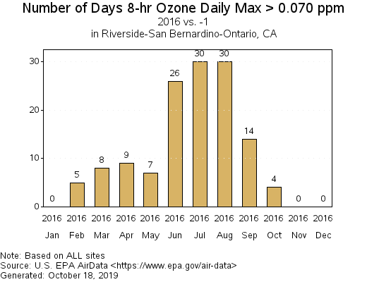
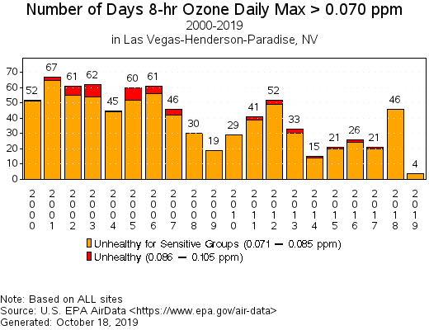
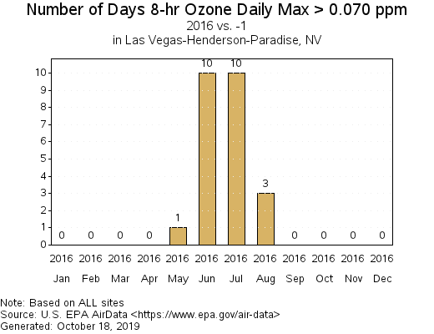
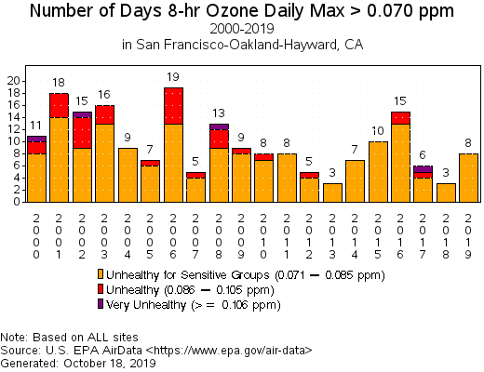
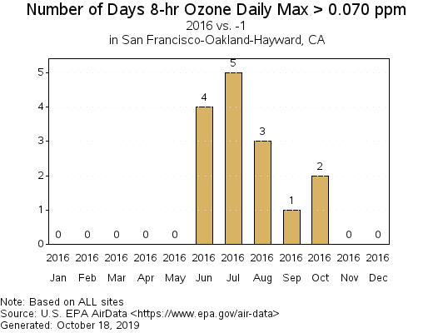
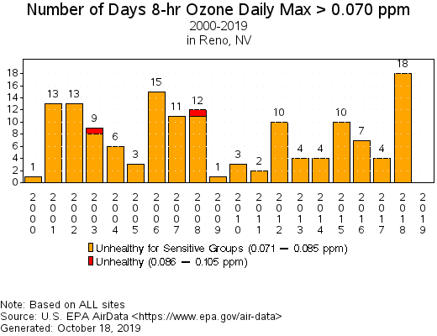
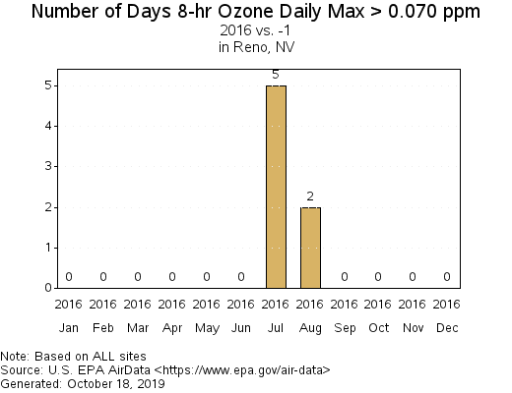
EPA Air Monitoring Data: West region
CA
NV

Slide 27
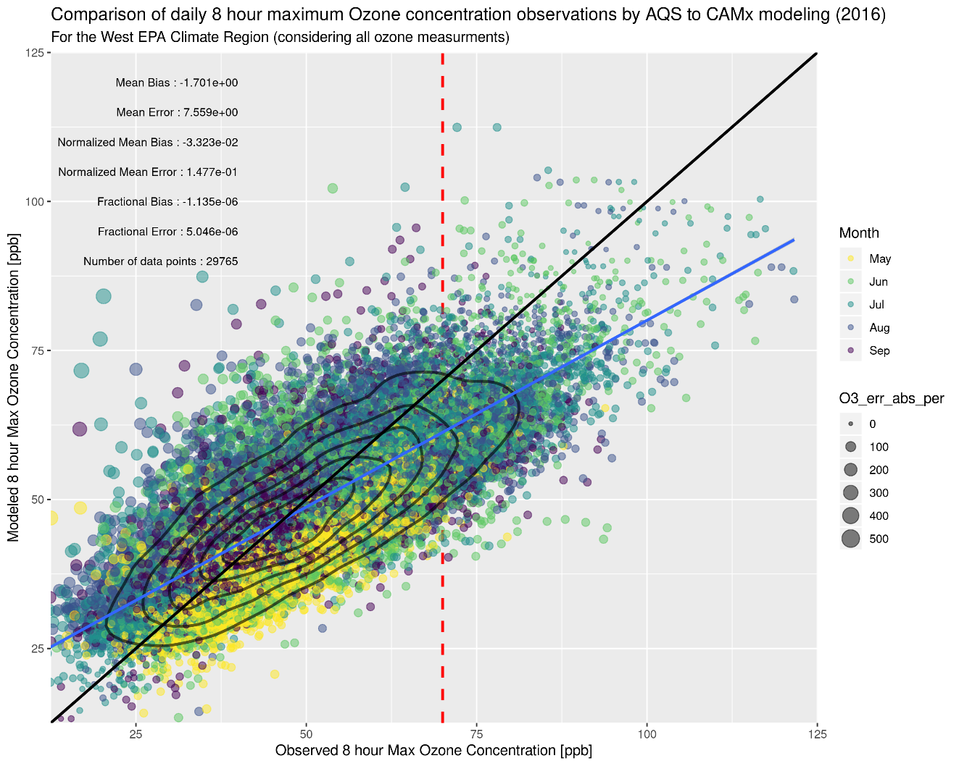
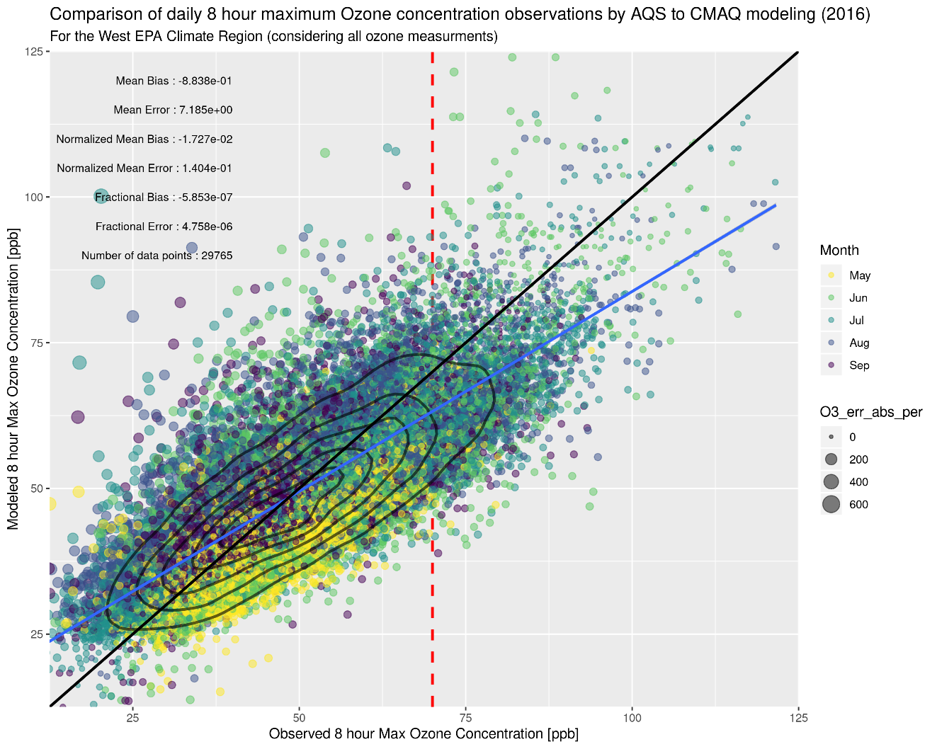
MDA8 Ozone Scatter Plot by Region/Season: West
CAMx
CMAQ

Slide 28
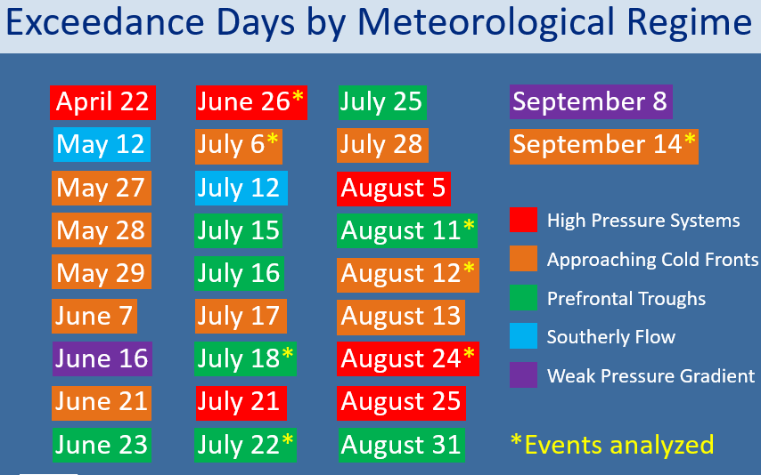


Slide 29
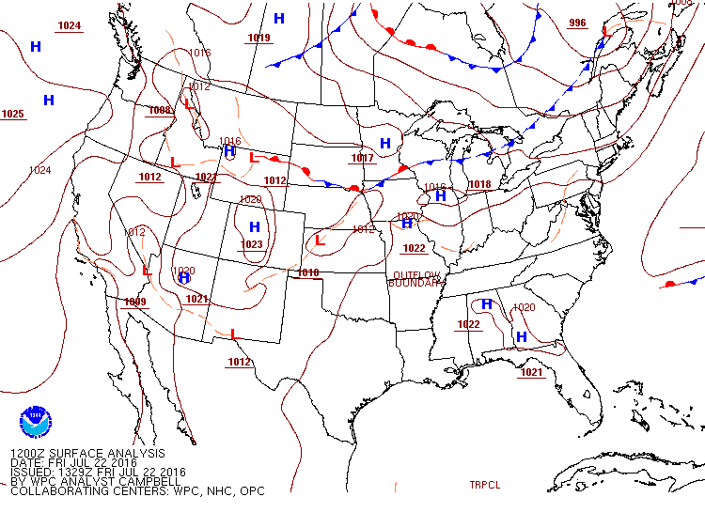
July 22, 2016 - Surface Analysis
Pre-frontal trough develops and funnels pollutants up the I-95 corridor
Mostly sunny skies throughout the day aid in ozone production
8:00 AM – 11:00 PM

Slide 30
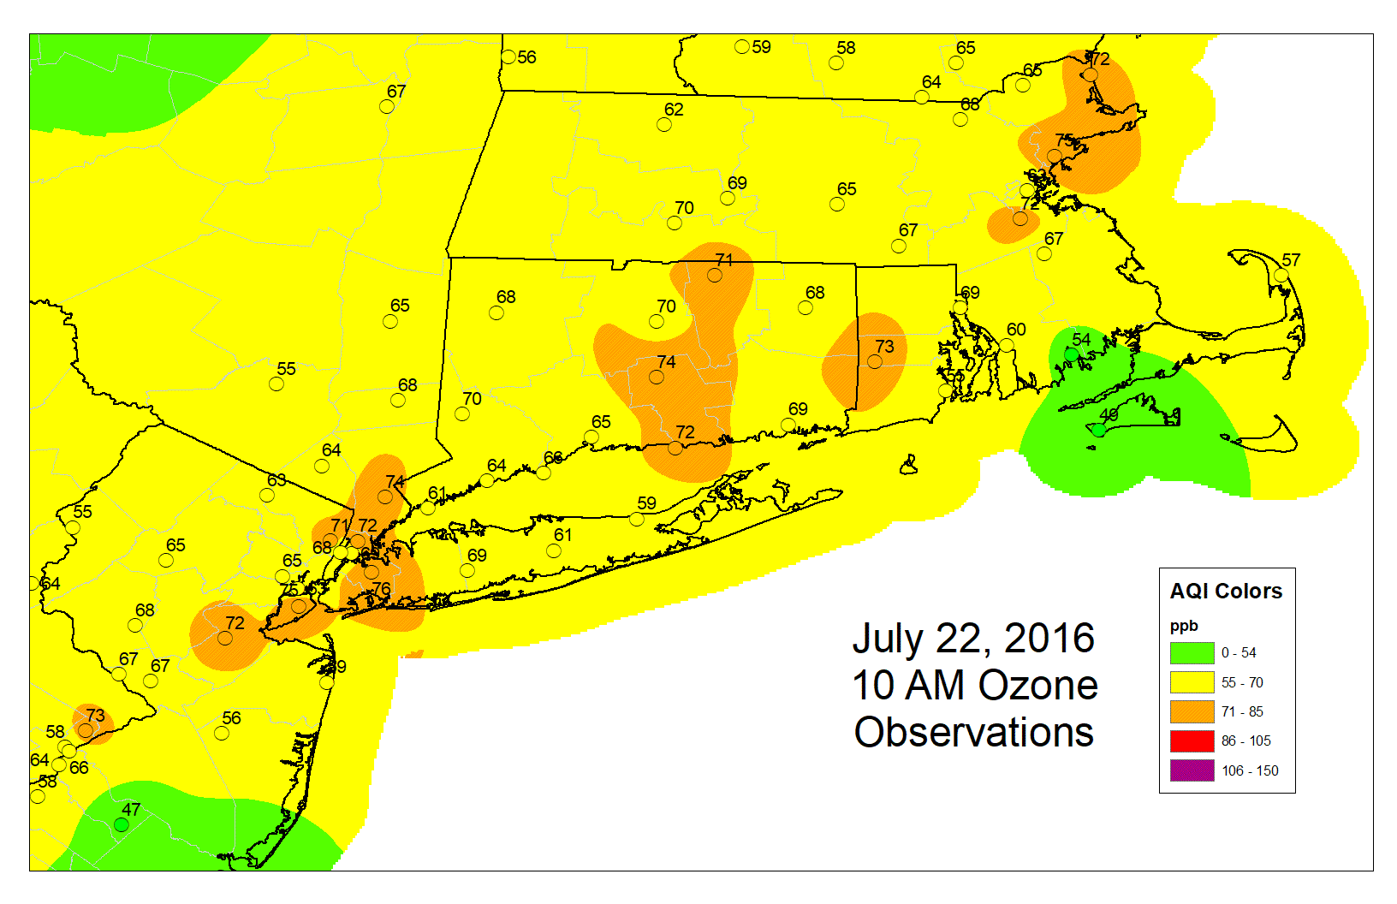
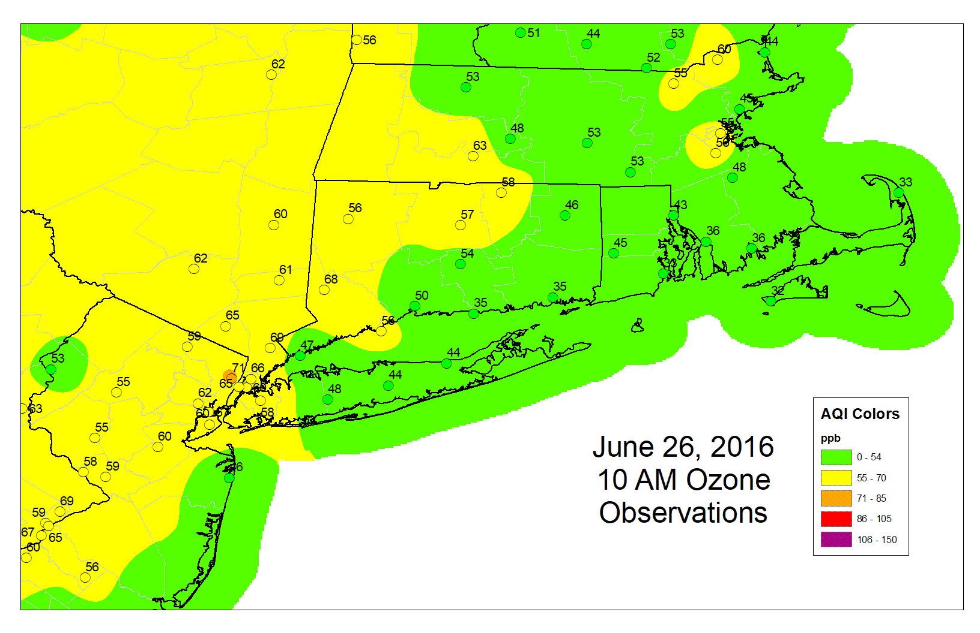
July 22, 2016 - Observations

Slide 31
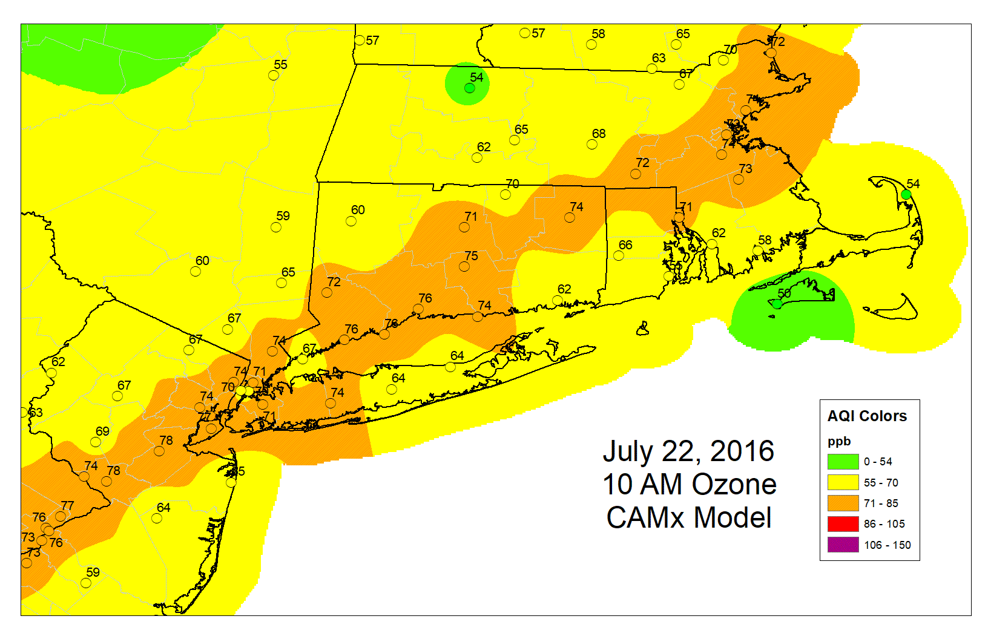
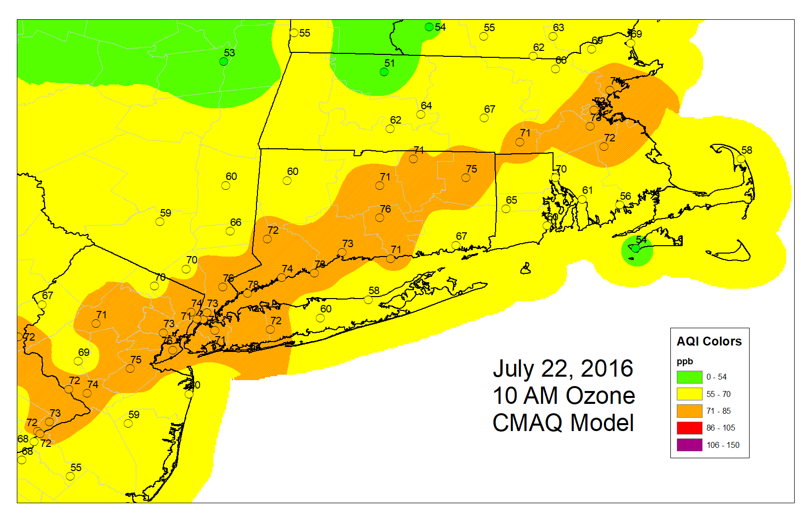
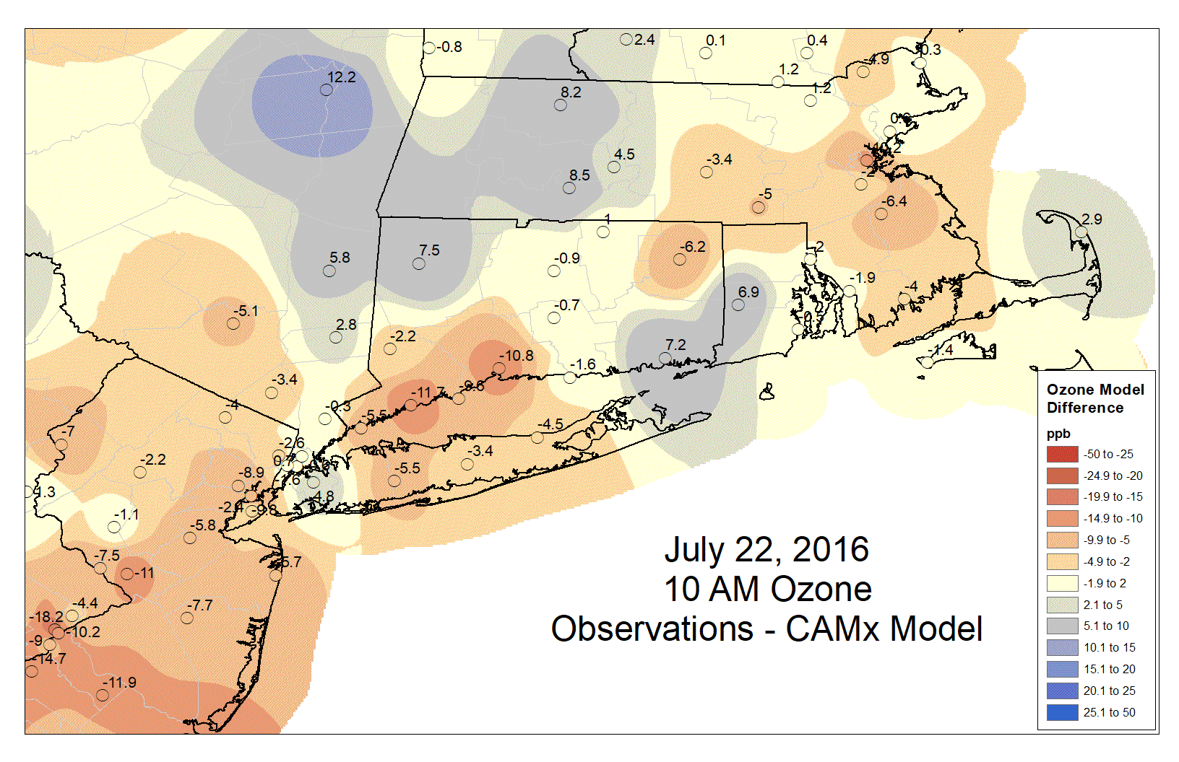
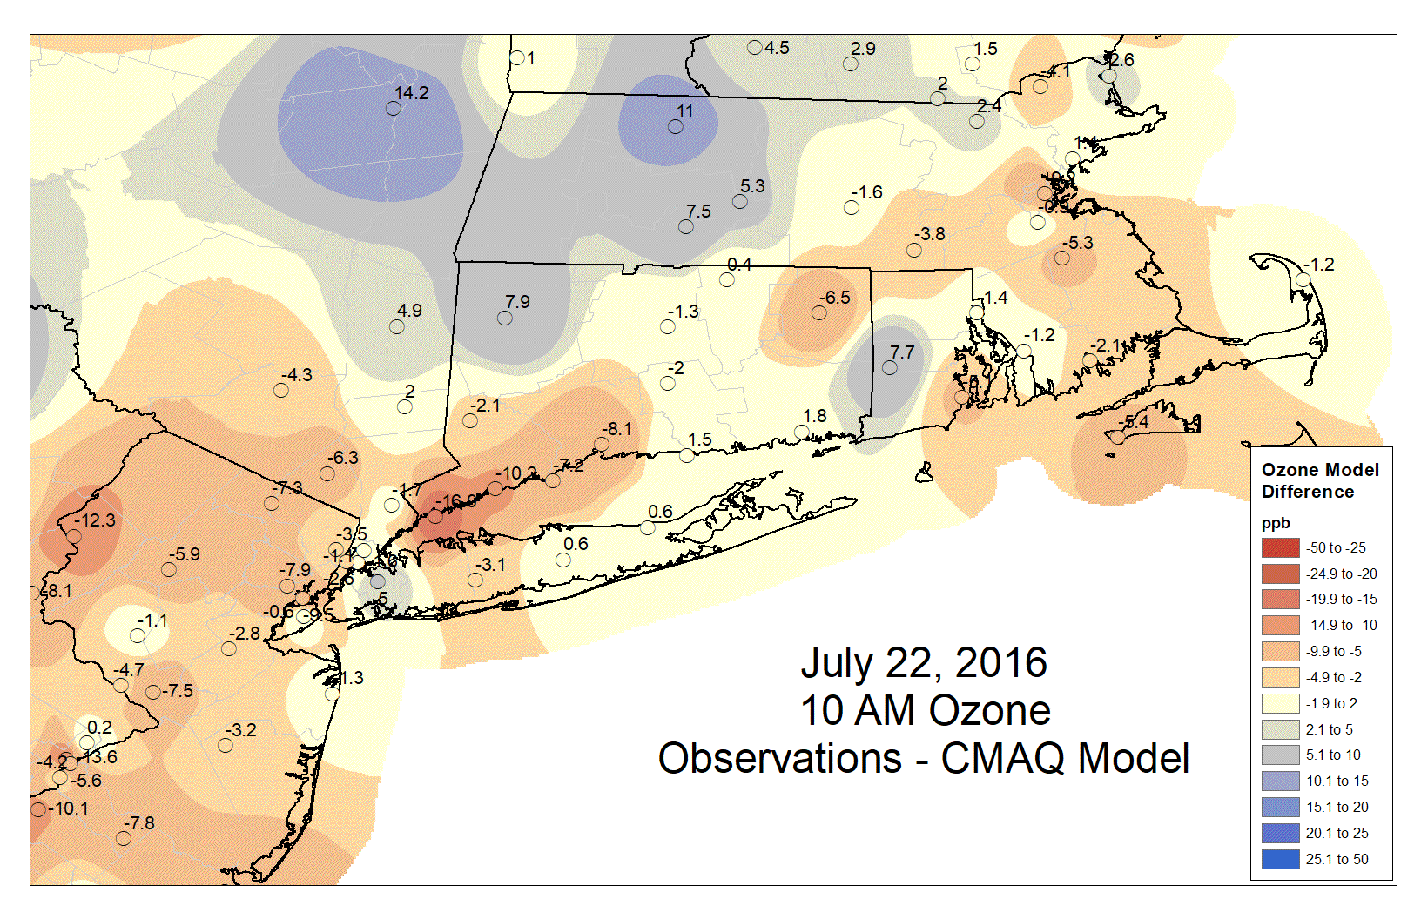
July 22, 2016 - CAMx vs CMAQ

Slide 32
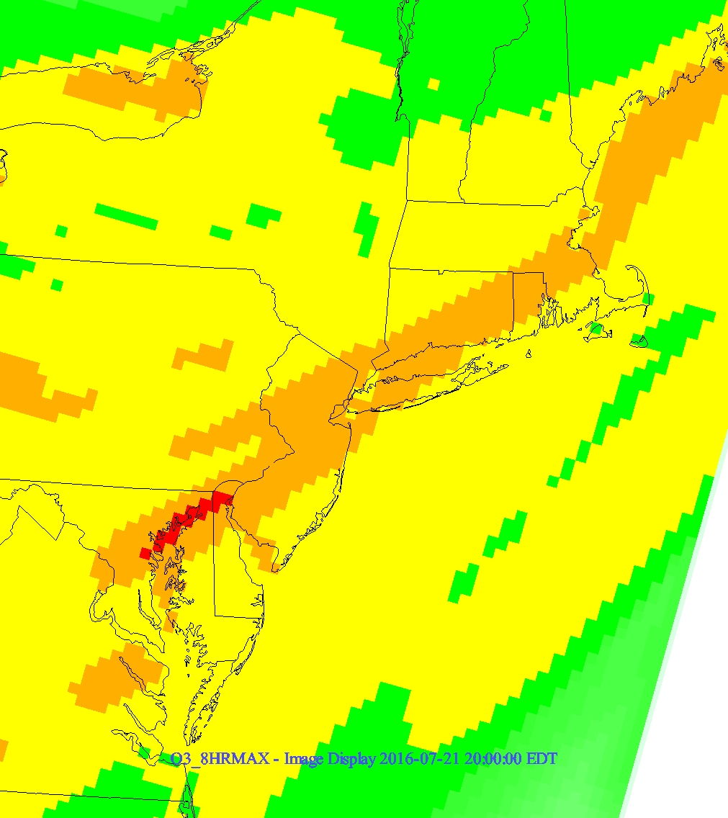
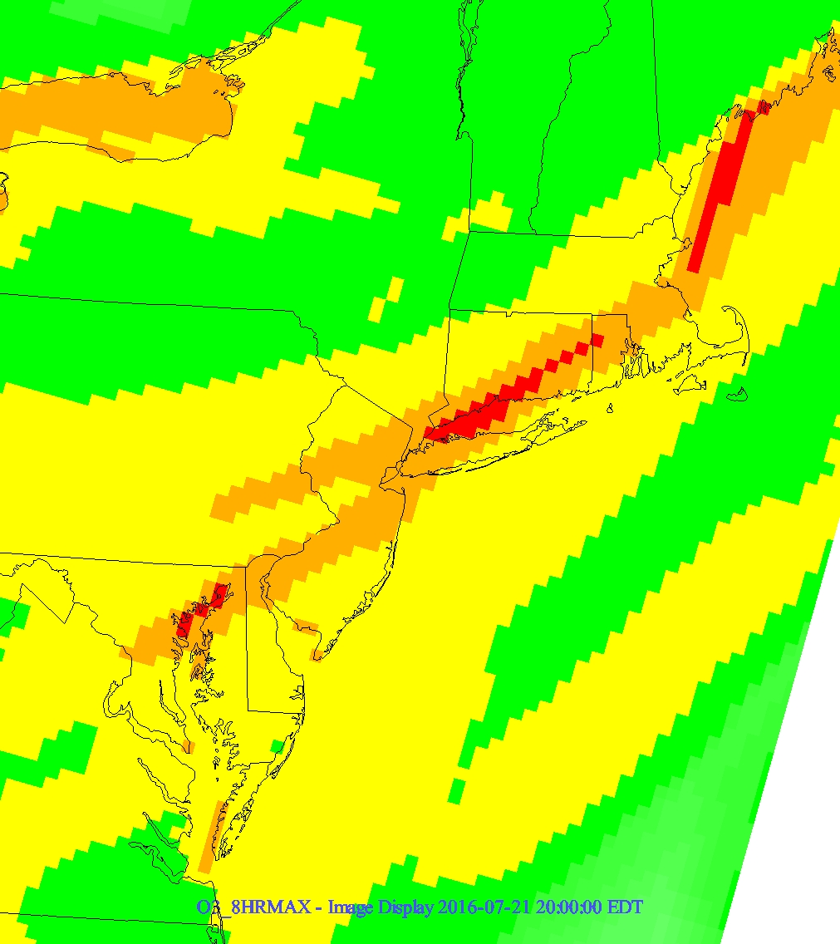
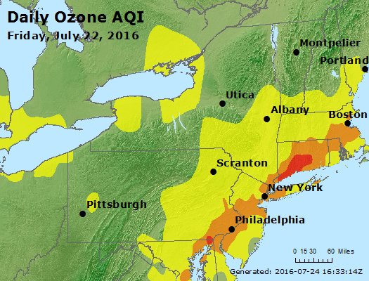
July 22, 2016 - CAMx vs CMAQ
CAMx CMAQ

Slide 33
High Pressure System Regime
  CAMx performed slightly better for both events
Approaching Cold Front Regime
  Both models represented the spatial extent of the exceedances well
East Coast/Prefrontal Trough Regime
  CMAQ handled this regime better, especially during the pop up thunderstorm
CMAQ generally predicts higher ozone levels in Connecticut under all regimes

Slide 34
Impact of Mobile Emissions Uncertainty on Air Quality Model Performance
Gil Grodzinsky, Ph.D.
Georgia Environmental Protection Division

Slide 35
Members
Gil Grodzinsky (GA EPD): Co-chair
Jin-Sheng Lin (VDEQ): Co-chair
Kristin Stumpf (VDEQ)
Sonya Lewis-Cheatham (VDEQ)
Byeong-Uk Kim (GA EPD)
James Boylan (GA EPD)
Tammy Smith-Hayes (GA EPD)
Mark Janssen (LADCO)
Erik Snyder (EPA Region 6)
Norm Possiel (EPA OAQPS)
Claudia Toro (ORISE Research Participant, EPA OTAQ)
Darrell Sonntag (EPA OTAQ)
Margaret Zawacki (EPA OTAQ)

Slide 36
Activities
07/16/2019: Introductions
08/12/2019: Vision, topics, schedule of presentations
09/09/2019: Presentation to the WG3, “CRC Research Studies Past and Present”, by Mark Janssen (LADCO)
10/08/2019: Presentation to the WG3, “MOVES Emissions Sensitivity Testing and Expanding to Air Quality Modeling” by Claudia Toro (ORISE, EPA OTAQ)
11/04/2019: Presentation to the WG3, “Overestimations of NOx Emissions by Models” by Mark Janssen (LADCO)
01/06/2020: Presentation to the WG3, “Ozone Sensitivity to Onroad NOx Emissions” by Byeong Kim and James Boylan (GA EPD)

Slide 37
Activities (cnt’d)
02/10/2020: Follow up to October presentation to the WG3 with poster, “Comprehensive bottom-up analysis of the onroad mobile emission sector: from NOx emission rates to air quality impacts“ by Claudia Toro (ORISE, EPA OTAQ)
06/08/2020: Review of vision, where to go from here (continue with focus on 2016v1 model platform, more input regarding MOVES input uncertainties, better ways to generate MOVES inputs for AQ models)
08/10/2020: Presentation to the WG3: “CMAQ Sensitivity Quantifying Ozone Impacts of Speed Distribution, Humidity Adjustment and Input Changes of Mobile Sector in 2016v1 Platform” by Jin-Sheng Lin (VDEQ) and discussion of next steps and SMOKE-MOVES

Slide 38
Mark Janssen: Past CRC Studies Identifying Uncertainties and Improvements in MOVES Inputs
Studies sponsored by the Coordinating Research Council (CRC):
CRC A-84: Age distribution, populations, VMT, road type VMT distributions and speed distributions found most impactful – sensitivity studies
CRC A-88: R.L. Polk (IHS) data for age distribution/population and Freight Analysis Framework (FAF) data for long-haul VMT fractions, hoteling hours identified as most reliable datasets
CRC A-100: Telemetry data acquired to better estimate average speed distributions, hour/day VMT fractions, and road type VMT distributions
CRC A-103: Guided MOVES users on running MOVES or preparing SMOKE-MOVES inputs for the cloud environment – few could run SMOKE-MOVES from start to finish so limited impact
CRC A-110: Tried to improve efficiency and speed of MOVES runs through use of the cloud environment and modification to core functions – limited success like CRC A-103
CRC A-115: Reviewed 4 age distribution profiles and vehicle populations for 2016 and 2017 – Recommended adjustments be made to default data for 2016 platform and 2017 NEI to account for antiques and older vehicles no longer in service

Slide 39
Claudia Toro: MOVES Emissions Sensitivity Testing and Expanding to Air Quality Modeling
Focus on Light Duty (LD) Vehicles and NOx
Claudia found bottom-up approach more informative in identifying variables most impacting emissions
High power conditions, deterioration rates for running and starts were investigated
  Could be adjusted to match model with observations (except winter AM)
  High power rates become most impactful in future years
SE and NE US ozone most impacted by these NOx variations
Caveats:
  Emissions national scale
  Bottom-up can miss impacts of other sectors (top-down covers all)

Slide 40
Claudia Toro: MOVES Emissions Sensitivity Testing and Expanding to Air Quality Modeling
Suggestions
  Add CO and HC pollutants
  Scaling factors need to be clarified and too simplified, incorporate SMOKE-MOVES approach next time
  Compare use of CRC data versus state supplied data on pollutant concentrations
  Run local
Study intended to only obtain preliminary findings of potential impact of LD vehicle emissions changes on modeled ambient levels of NOx

Slide 41
Mark Janssen: Overestimations of NOx Emissions by Models
LD vehicles overestimation - grams pollutant/kg fuel burned decreasing over time but modeling not fully capturing this
Satellites (TROPOMI) not showing emissions signatures from interstates
HD vehicles underestimation – Idling greater than 10 minutes not handled in MOVES (except long-haul truck hoteling)
UC Riverside study/MARAMA presentation - very high percentage of HD diesel vehicles that were running with the SCR at 200°C or lower
  Emission control is not very effective at this temperature: could lead to high NOx emissions
Wanted more data from EPA to further estimate if this HD vehicle issue is of greater concern or if Riverside study was just flawed
  Current evidence demonstrates for high ozone days, model biased high so maybe EPA not underestimated
EPA mentioned next version of MOVES will fill in this gap

Slide 42
Byeong-Uk Kim and James Boylan: Ozone Sensitivity to Onroad NOx Emissions
Investigated the sensitivity of ground-level ozone to onroad NOx emissions
      Model Performance
      Design Values
2011 CAMx (based on EPA’s “eh” platform)
      Base run
      33% onroad NOx cut run
      50% onroad NOx cut run

Slide 43
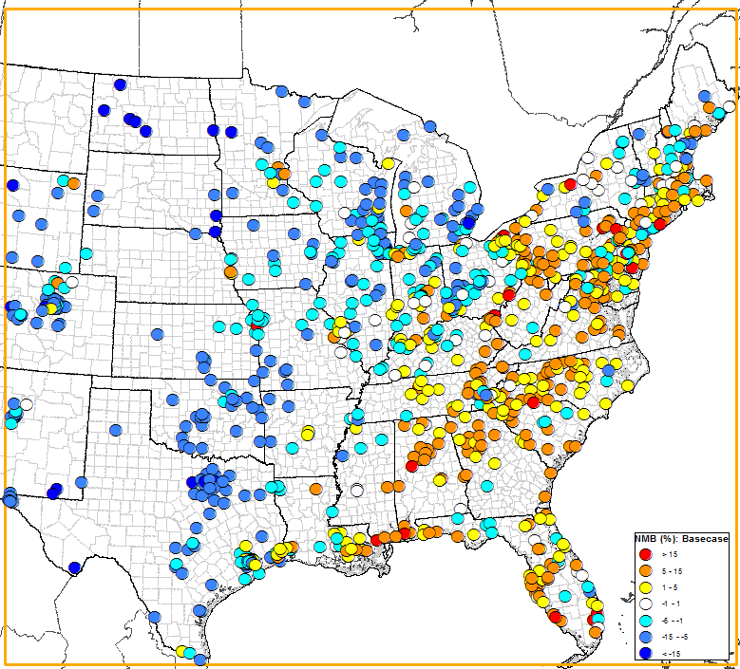
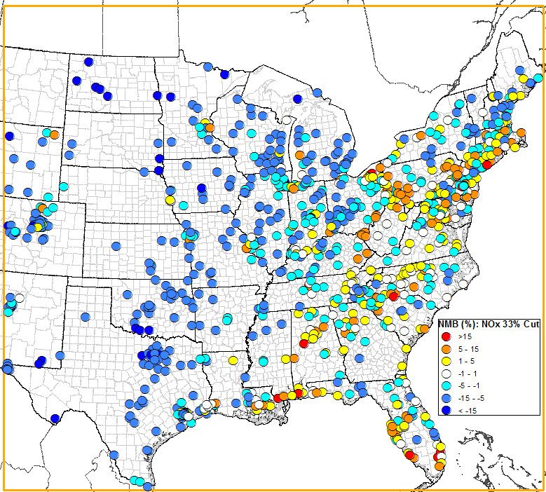
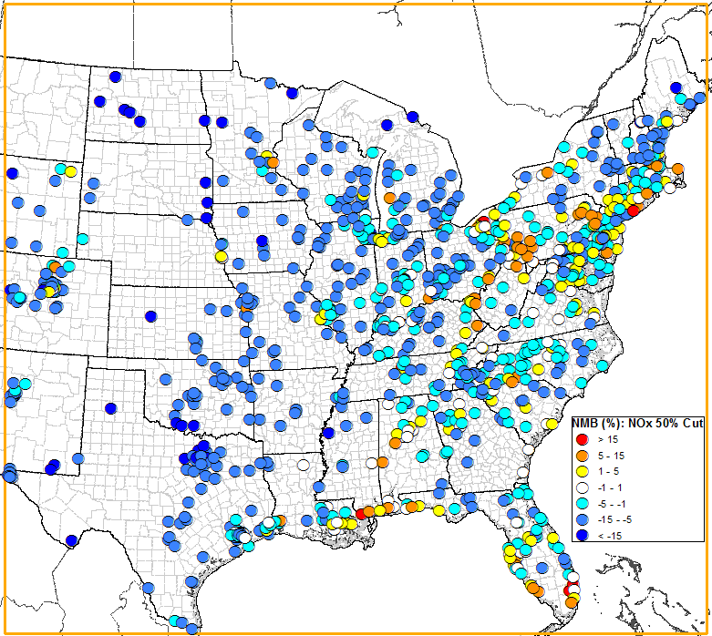
Normalized Mean Bias: OS, MDA8O3 (60 ppb Cutoff)
Base Run
33 % Onroad NOx Cut
50 % Onroad NOx Cut
Overpredictions in SE
Good performance in SE
Underpredictions in SE

Slide 44
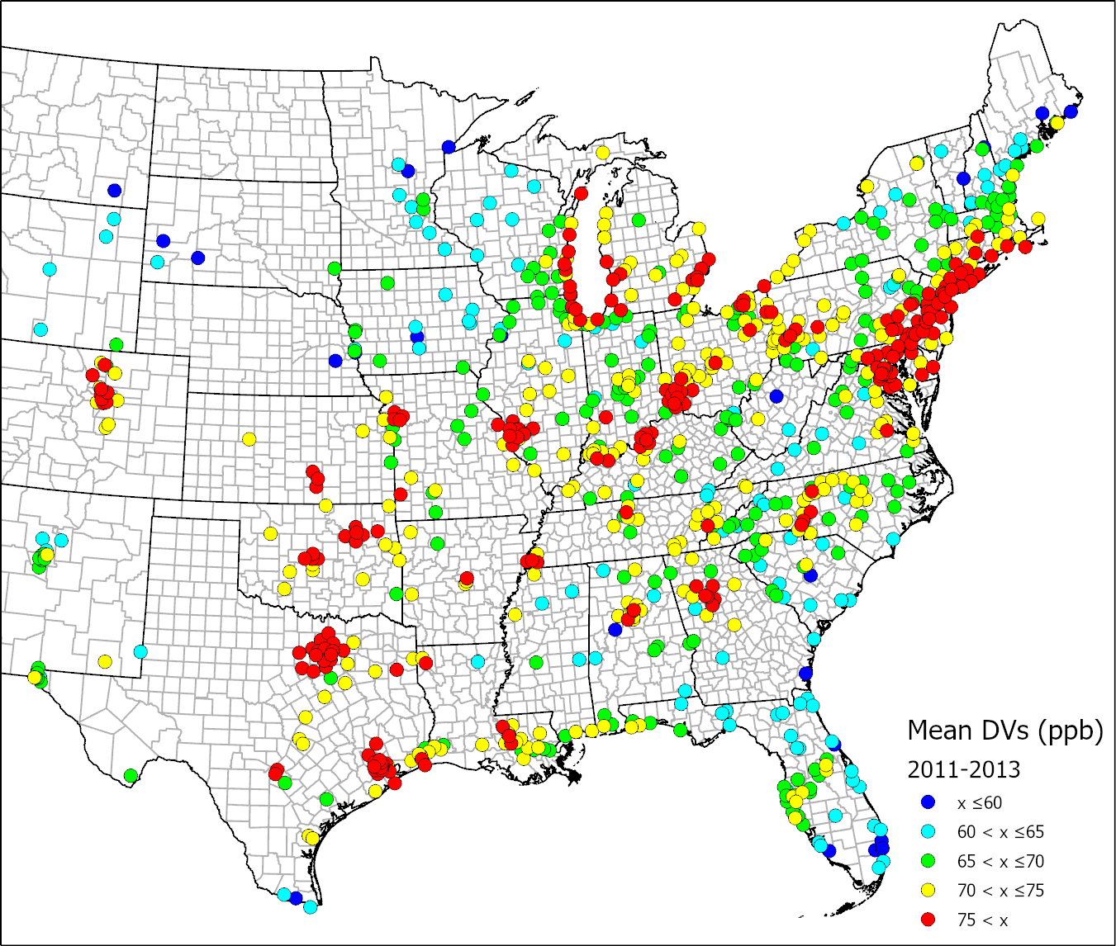
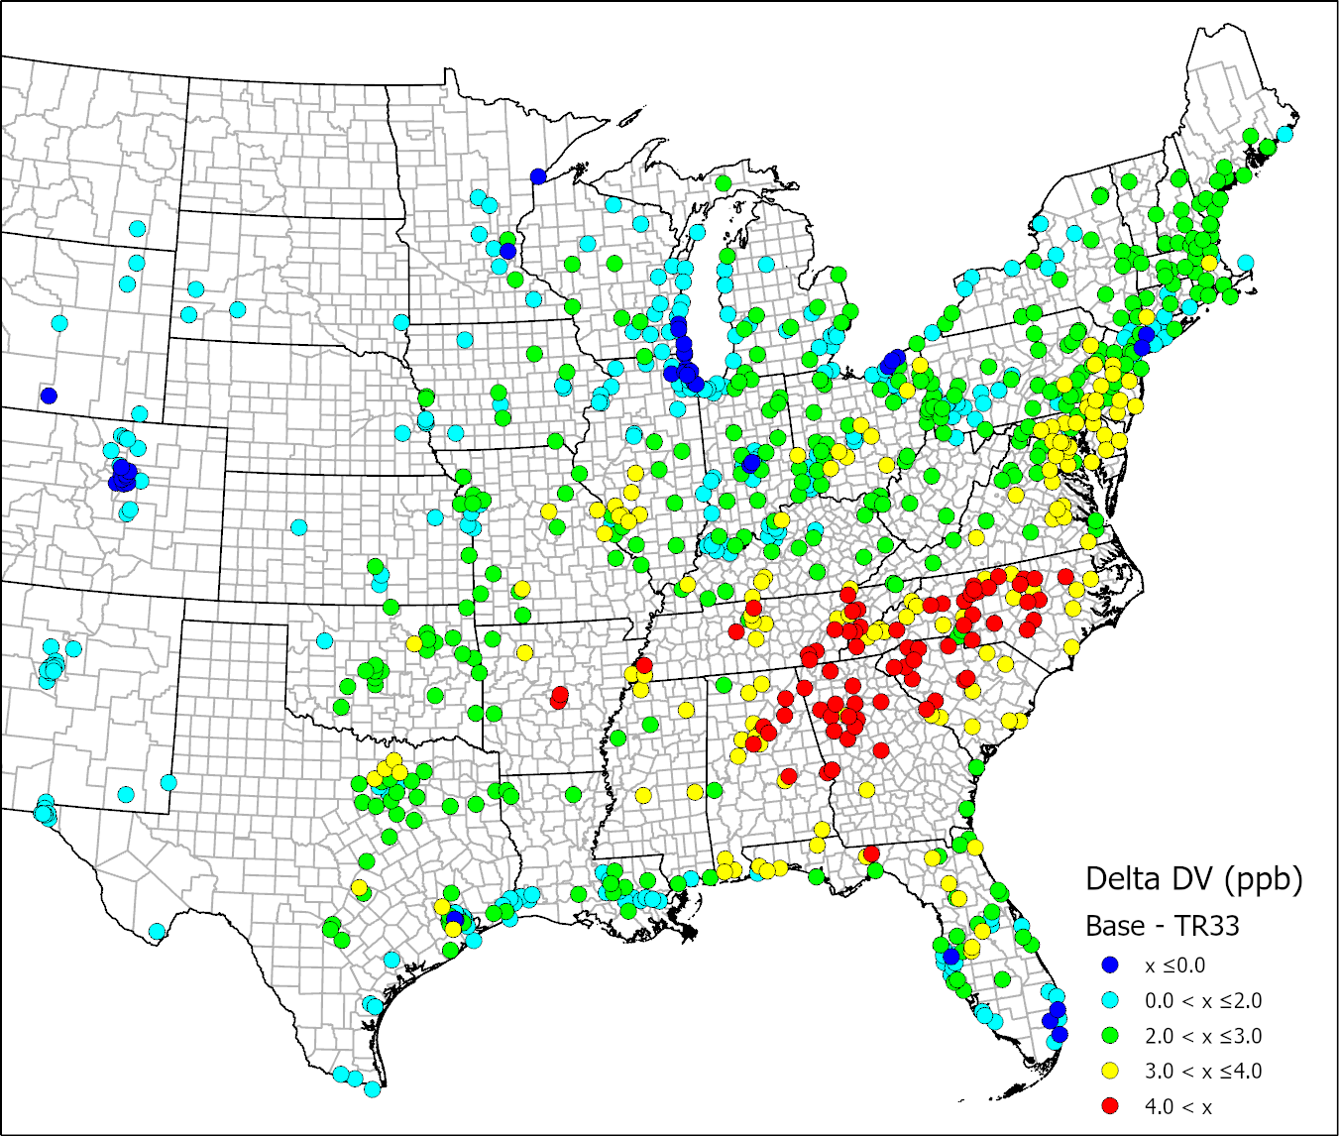
Impact on Design Values
Average DVs (2011-2013) ΔDVs (${DV}_{AVG}−{DV}_{33\%Cut}$)

Slide 45
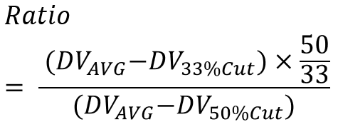
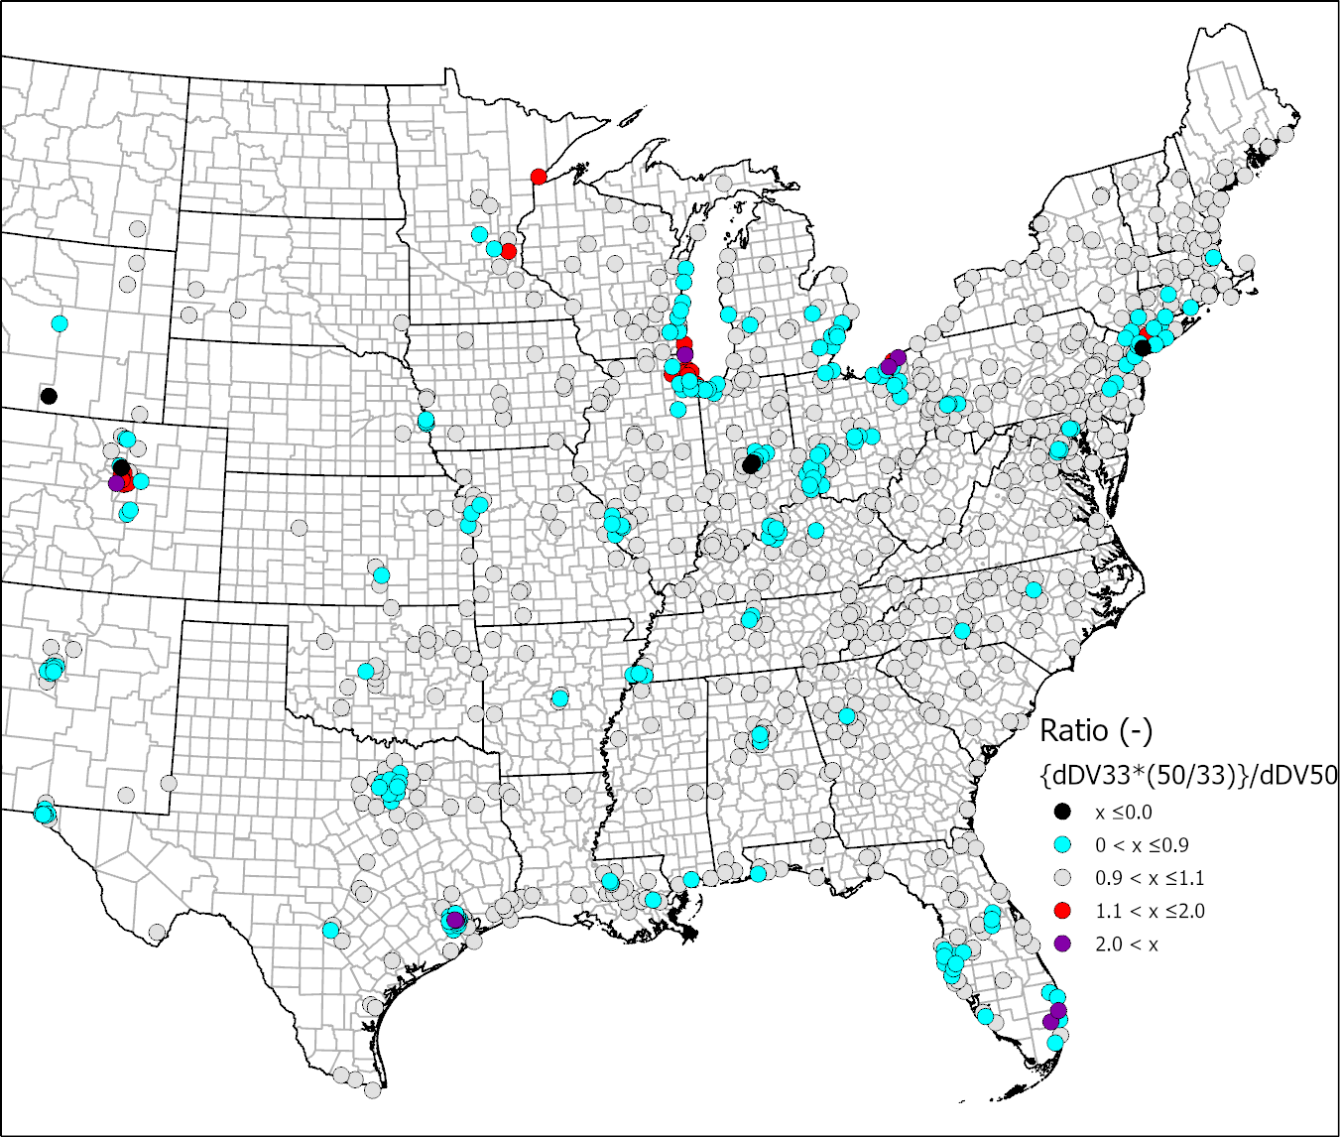

Ratio of Ozone Design Value Changes

Slide 46
Estimating Ozone DV Impacts
Ozone DV impact from a domain-wide 33% onroad NOx reduction
    Atlanta (13-121-0055) = 3.9 ppb
    Baltimore (24-251-1001) = 3.5 ppb
    Chicago (17-097-1007) = -0.2 ppb
EXAMPLE - Estimated impact of local 5% onroad NOx reduction due to updated age distributions in MOVES
    Atlanta (13-121-0055) = 3.9*(5/33) = 0.59 ppb
    Baltimore (24-251-1001) = 3.5*(5/33) = 0.53 ppb
    Chicago (17-097-1007) = -0.2*(5/33) = -0.03 ppb

Slide 47
Jin-Sheng Lin: CMAQ Sensitivity Quantifying Ozone Impacts of Speed Distribution, Humidity Adjustment and Input Changes of Mobile Sector in 2016v1 Platform
Sensitivity of the CMAQ air quality model going from:
  NEI2016 beta to NEI2016 v1 inputs
  gridded hourly vs. average relative humidity
  speed distributions vs. average speed.
Ozone concentrations based on summertime NOx running emissions variations across continental US
4 scenarios analyzed and compared
  Base case with all updates (NEI2016v1, hour gridded RH, speed distribution)
  Base case except average speed
  Base case except average RH
  Case with no updates (NEI2016 beta, average speed and average RH)

Slide 48
Jin-Sheng Lin: CMAQ Sensitivity Quantifying Ozone Impacts of Speed Distribution, Humidity Adjustment and Input Changes of Mobile Sector in 2016v1 Platform
Summary of Results:
  NEI2016 beta ➔ NEI2016v1: Greatest impact on ozone (up to 3-5ppb decrease in ozone from large decreases in NOx) due to changes in representative counties and age distribution (except for some northeastern states due to VMT/VPOP updates, or a switch from state-supplied speed to CRC telemetric speed)
  Average speed ➔ speed distribution: Potential increase of 1-2ppb ozone from NOx emissions increase
  Constant average RH ➔ hour gridded RH: Increase eastern US (up to 1-2ppb), decrease western US
  Relative humidity adjustments most complicated: decrease in NOx emissions with increase in RH

Slide 49
James Boylan: SMOKE-MOVES
CMAQ/CAMx sensitivity and uncertainty testing requires multiple AQ model runs with different MOVES input/ output files
The current SMOKE-MOVES system is resource intensive
  Very few states have the knowledge or resources to rerun SMOKE-MOVES from start to finish in-house
  States must rely on EPA for SMOKE-MOVES outputs
Need to develop an easier process for states to develop new MOVES output files for CMAQ/CAMx modeling
  EPA could provide training to states on how to run SMOKE-MOVES
  EPA could provide cloud computing services for states to run SMOKE-MOVES
  EPA could update and simplify the current SMOKE-MOVES process
  EPA could replace SMOKE-MOVES with inventory MOVES (see next slide)

Slide 50
SMOKE-MOVES vs. MOVES-SMOKE
Run MOVES in inventory mode to produce hourly outputs for an entire year
  Most states have the knowledge to run inventory MOVES in-house
  Can use hourly meteorology (similar to SMOKE-MOVES) or diurnal monthly average meteorology
  Can use hourly observed meteorology or WRF meteorology
  Removes many simplifying assumptions used in SMOKE-MOVES
Inventory MOVES outputs can be run through SMOKE to produce hourly gridded emissions for photochemical modeling
  Process is called “MOVES-SMOKE”
  Inventory MOVES can provide hourly speciated emissions
  SMOKE would be used for spatial allocation (i.e., gridding)

Slide 51
Long Range Smoke Impacts on Model Performance
Mat Hollinger
Indiana Department of Environmental Management
mhollin@idem.in.gov

Slide 52
Workgroup Members
EPA
  Norm Possiel - OAQPS
  Kirk Baker - OAQPS
  Robert Imhoff – Region 6
  Lance Avey – Region 7
States
  Michael Giegert – Connecticut
  Mat Hollinger – Indiana
LADCO
  Zac Adelman
  Tsengei Nergui

Slide 53

MOTIVATION

Slide 54


Slide 55
Charge Questions
1. How well does the air quality modeling system simulate fire smoke transport?
2. Does the model capture surface ozone/PM enhancements from long range smoke transport?
3. To what extent does the model capture exceptional events from wildfires?
4. What additional analyses or data are needed to evaluate long range smoke transport enhancement to surface air pollution concentrations?

Slide 56
Topics Covered
LADCO Exceptional Event Screening Tools
Satellite Retrievals
Rim Fire Modeling (2013)
Flint Hills Fires (April 2016)
Fort McMurray Fire (May 2016)

Slide 57


Underprediction in the Midwest of Ft. McMurray Smoke Impacts
The EPA –beta model for May 24, 2016, failed to predict the USG ozone buildup over the eastern Great Lakes. ​

Slide 58


CO Observations

Slide 59

May 18th, 2016 Modeled CO
Notes:
This image shows the vertical CO profile to the east of the Fort McMurray fire, where the highest CO plume was observed to occur. This shows that the smoke plume likely penetrated above the .600 CMAQ model level. However, it’s unclear if the model brings the CO back to ground level.

Slide 60
Fort McMurray - Conclusions
CO modeled well, lagged a day
Emissions Estimate with Satellite Hotspot Detection
Questionable Diurnal Burn Cycle
Injection of CO into the Troposphere
Very little model CO impact at surface
Impacts from Mexican fires in Southeast and Mid-Atlantic
Notes:
CMAQ modeled CO for the Fort McMurray wildfire reasonably coincides with the fire activity, although it appears to lag behind by a day.
Overcast skies hamper the hotspot detection, which causes the emissions to decrease. This may have to be compensated for in the future.
Although a diurnal burn cycle may be reasonable in some cases, this must be questioned in the case of a major, constantly burning wildfire.
It appears that a portion of the CO is being injected to the 700mb level over the fire and above 600mb further downwind, which would allow for long distance transport. However, it is possible with pyro-cumulus cloud production, that pollutants may have reached much higher altitudes and were transported further.
The modeled 36km domain appears to captured the Fort McMurray CO plume, but it appears that very little of it may have impacted at ground level, hence the under-prediction of surface ozone.
It appears that pollutants from fires to the south may have been the primary source of modeled ozone precursors for the mid-Atlantic States during late May 2016.

Slide 61
Ending Issues
Fire in 36 km grid cell versus 12 km grid cell
Plume vertical mixing and photolysis
Influence of closer fires over more distant ones
Effects of cloud cover on satellite retrieval and burn area analysis
Effects of CO underprediction
CO vertical lofting and dispersion

Slide 62
Model Bias & Response to Emissions Changes
Byeong-Uk Kim, Ph.D.
Georgia Environmental Protection Division

Slide 63
Members
Saffet Tanrikulu (BAAQMD): Co-chair
Byeong-Uk Kim (GA EPD): Co-chair
Bonyoung Koo (BAAQMD)
Yuanyuan Fang (BAAQMD)
Claudia Toro (EPA)
Gail Tonnesen (EPA)
Molly Zawacki (EPA)
Norm Possiel (EPA)
Jim Boylan (GA EPD)
KJ Liao (GA EPD)

Slide 64
Activities
08/14/2019: Discussed the topic and expectations
09/23/2019: Presentation to the WG1, “Impact of Model Bias on Model Projections and Contributions” by Byeong-Uk Kim (GA EPD)
06/03/2020: Presentation to the large group, “Impact of Model Bias on Future Design Values” by James Boylan (GA EPD)

Slide 65
Impact of Model Bias on Model Projections and Contributions
Byeong-Uk Kim and James Boylan
Georgia Environmental Protection Division

Slide 66
RRF = Future Year / Base Year
RRF = 0.7 for all cases
77/110 = 0.7
70/100 = 0.7
63/90 = 0.7
High Bias
110 ppb
Reality
100 ppb
77 ppb
(-33 ppb)
DVF = RRF * DVC
90 ppb
Low Bias
70 ppb
(-30 ppb)
63 ppb
(-27 ppb)
~
~
~
~
BY
FY
Assumption: Biases in the base year are canceled by biases in future years.

Slide 67

Georgia Example
In EPA’s CSAPR modeling, Georgia (downwind state) contributes 0.71 ppb to the Denton monitor in Dallas, TX (upwind monitor).
  Georgia has a 25.1% high bias averaged across the state. Georgia’s absolute contribution should be scaled down to account for the model bias (0.71 ppb ➔ 0.53 ppb).
The bias at the Denton monitor is -6.5% on the days included in the contribution calculation. EPA’s approach uniformly scales APCA contribution results to match the modeled future DV, even if the reason for the low bias is missing local contributions.
If the Georgia APCA results are not scaled by APCA, the Georgia contribution would be even less (0.53 ppb ➔ 0.497 ppb).
If MPE adjustments are not made, the Georgia ozone contributions at Denton are overestimated by 43% (0.71 vs 0.497 ppb).

Slide 68
North Carolina Example
According to EPA’s proposed ozone transport rule modeling NODA (7/23/15), if a downwind state contributes more than 1% of the NAAQS (0.75 ppb) to an upwind state’s nonattainment, the downwind state “significantly contributes”.
  According to the recent NODA, in 2017 NC contributes 0.93 ppb to the Essex monitor (Baltimore, MD).
On 3 of the 15 days, the mean bias was 42.6%, 46.5%, and 71.3%.
  Removal of these three days reduces the NC contribution (0.93 ppb ➔ 0.45 ppb).
This adjustment would have policy implications by removing NC from the 2008 ozone NAAQS transport rule requirements and costly NOx controls.

Slide 69
Impact of Model Bias on Future Design Values
  Odman M.T., Qin M., Hu Y., Russell A.G., Boylan J.W., 2020. Interstate transport of ozone in eastern United States: An analysis of the impact of southeastern states’ emissions in 2017, Atmospheric Environment, Volume 236, September 1, 2020, 117628. https://doi.org/10.1016/j.atmosenv.2020.117628
James Boylan
Georgia Environmental Protection Division
06/03/2020

Slide 70
Model Set-Up
Base year = 2011, Future year = 2017
EPA’s 2017 “eh” inventory (with updates)
12-km hor­i­zon­tal res­o­lu­tion
CAMx
  CAMx ver­sion 6.11
  CAMx used the Car­bon Bond-Ver­sion 6 (CB6r2)
CMAQ
  CMAQ ver­sion 5.0.2
  CMAQ used the Car­bon Bond mech­a­nism CB05

Slide 71


Modeled (1x1) vs. Observed DVFs
CAMx (1x1) CMAQ (1x1)
DVF_{OBS} is based on 2015-2017 measurements.

Slide 72


Modeled (1x1) vs. Observed DVFs
CAMx (1x1) CMAQ (1x1)
12
12
8
8
13
17
DVF_{OBS} is based on 2015-2017 measurements.

Slide 73
Modeled DVFs Performance
The ac­cu­racy of DVFs pro­jected by dif­fer­ent meth­ods ranked from the high­est to low­est as fol­lows:
        CAMx/​CB6r2/​1×1 (MNB = −1.10%, MNE = 4.49%)
        CAMx/​CB6r2/​3×3 (MNB = −1.71%, MNE = 4.81%)
        CMAQ/​CB05/​1×1 (MNB = −2.35%, MNE = 5.06%)
        CMAQ/​CB05/​3×3 (MNB = −2.51%, MNE = 5.17%)

Slide 74

CAMx with CB6r2 (1x1)
DVF Bias = DVF (model) – DVF (observations)
MPE Bias = Model (top 10 modeled MDA8) – Observations (top 10 modeled MDA8)

Slide 75
CMAQ with CB05 (1x1)
DVF Bias = DVF (model) – DVF (observations)
MPE Bias = Model (top 10 modeled MDA8) – Observations (top 10 modeled MDA8)

Slide 76
CAMx (1x1) + CMAQ (1x1)
DVF Bias = DVF (model) – DVF (observations)
MPE Bias = Model (top 10 modeled MDA8) – Observations (top 10 modeled MDA8)

Slide 77
MPE Bias vs. DVF Bias
If the MDA8 ozone over­es­ti­ma­tion is larger than 25 ppb, then DVF was al­most al­ways un­der­es­ti­mated.
On av­er­age, the DVF bias decreases by 1.3 ppb for every 10 ppb of MDA8 ozone over­es­ti­ma­tion in 2011.
        CAMx with CB6r2: 1.9 ppb decrease for every 10 ppb
        CMAQ with CB05: 1.2 ppb decrease for every 10 ppb

Slide 78
CMAQ modeling comparisons between using EPA & IPM and ERTAC EGU options and the preliminary 2023 DVFs
Jeongran Yun, NYS DEC
Co-authors: Winston Hao, Eric Zalewsky, Ruby Tian, Kevin Civerolo

Slide 79
CMAQ Model runs
1) 2016v1 (fh), CMAQ v5.3.1, EPA & IPM EGU(2016 and 2023)
2) 2016v1 (fh), CMAQ v5.3.1, ERTAC EGU(2016 and 2023)
EMISSIONS: 2016 fh emissions (with CMV updates),
New egucems files not reflected,
Airport emissions not updated,

Slide 80
Modeling components
 | 2016 fh platform modeling
Emissions | 2016 V1 (fh) emissions inventory
EGU point | EPA & IPM, ERTAC
Meteorology | WRF v3.8 (provided by EPA), MCIP v5.0 (processed by NYSDEC)
Boundary/Initial conditions | 36US3 run using CMAQv5.3.1 and 2016 V1 emissions for 2016 and 2023 (NYSDEC)
Domain | New expanded OTC 12 km domain
Modeling period | April to October
Model layers | 35
Model | CMAQ v5.3.1
Science Option | Offline beis, no WBDust model, no lightning NOx, M3dry, NH3 bidi
Modeling years | 2016 and 2023

Slide 81




Daily max 8 hour (MDA8) ozone
Mean Bias
with 60 ppb threshold
CMAQ v5.3.1, 2016fh, EPA EGU
CMAQ v5.3.1, 2016fh, ERTAC EGU
May-Jun
Jul-Aug

Slide 82





Comparisons of average hourly ozone in
Nonattainment Areas in Northeast
MAY
JUNE
JULY
AUGUST

Slide 83

Location of selected sites

Slide 84


MDA8 ozone time series obs vs mod
Queens College, NY
Pfizer Lab, NY

Slide 85


MDA8 ozone time series obs vs mod
Atlanta, GA
Cook County, IL

Slide 86


Difference of MDA8 ozone (July)
EPA & IPM – ERTAC EGU
2016
2023

Slide 87
2023 DVF/model run combinations
1) EPA EGU (2016), IPM (2023)
2) ERTAC (2016), ERTAC (2023)

Slide 88
RRF and DVF calculations
DVF = RRF * DVB
  DVF: estimated design value for the future year
  DVB: base design value, 5 year weighted average design value
    ((2014-2016 DV)+(2015-2017 DV)+(2016-2018 DV))/3
  RRF: Relative Response Factor, based on an average of 10 highest daily max 8 hour ozone greater than 60 ppb where possible (at least 5 days with > 60 ppb) in the base year
RRF calculation
  1) 3x3 approach: Use 3x3 grid cells centered on the grid cell where the monitor site is located.

Slide 89


2023 DVF using two EGU options
3x3 approach
IPM
ERTAC

Slide 90

2023 DVF (pre truncated) difference between two EGU options
IPM – ERTAC (3x3 approach)
The stars indicate there is only one value to compare

Slide 91
Observations
Base year CMAQ model results using both EGU options show high bias around some coastal areas like the Long Island sound and some areas near the Great Lakes in July and August.
Daily max 8 hour ozone between CMAQ using the IPM and ERTAC options show large differences over some areas in the future year (2023), compared to the base year (2016). This is due to the two EGU options having different projections over some areas.
DVFs using the ERTAC option are generally higher up to about 1 ppb, compared to the IPM option for most regions in the US.
Some areas like NC (IPM higher), LA, and IN-KY (ERTAC higher) show relatively large differences in DVFs between the IPM and ERTAC option.
There have been updates to both EPA & IPM and ERTAC EGU inventories since our modeling was done. We plan to incorporate these changes in our future runs.

Slide 92
CAMx 2016v1 MPE Results in the Great Lakes Region: Ozone Precursors
Zac Adelman, LADCO

Slide 93

LADCO 2016v1 CAMx Modeling
April – October 2016 CAMx v7.0beta4
US EPA 12US1 WRF Meteorology
US EPA 2016 Hemispheric CMAQ BC’s
2016v1 emissions data
EPA 2016fh_16j SMOKEv4.6 modeling platform, processed to 12US2 domain
Evaluation with AMETv1.3

Slide 94

Daily Max 8-Hour Ozone (MDA8) Performance
National MDA8 O3 Season (April-October)
All AQS and CastNET sites
NMB/E = Normalized Mean Bias/Error
FB/E = Fractional Bias/Error
 | NMB | NME | FB | FE
AQS | -3.3 | 14.7 | -3.2 | 15.7
CastNET | -4.4 | 14.4 | -3.9 | 15.2

Slide 95

O3 Season MDA8 O3 Normalized Mean Bias

Slide 96






Monthly MDA8 O3 Normalized Mean Bias
April May June
July August September

Slide 97



O3 Season Normalized Mean Bias
O3
Comparing O3 to measured precursors
  NO2 ~ mobile, combustion
  Formaldehyde ~ VCPs, mobile, combustion
  Isoprene ~ biogenics
Measurements are sparse
No obvious patterns across the season
NO2 Isoprene Formaldehyde

Slide 98






Monthly NO2 Normalized Mean Bias
April May June
July August September

Slide 99





IL April – October
O3 and Precursors
MDA8 O3 AQS MDA8 O3 CASTNet
Increase in NO2 and HCHO positive biases may correspond with the O3 bias change in July
High positive biases for Isoprene in April-May may indicate a problem with the leaf-out prediction
NO2 Isoprene Formaldehyde

Slide 100





IN April – October
O3 and Precursors
MDA8 O3 AQS MDA8 O3 CASTNet
The O3 and NO2 trends in IN are similar to IL but HCHO is underpredicted in all months
Mean NO2 and Isoprene performance look good, but the devil is in the details
NO2 Isoprene Formaldehyde

Slide 101




Lake County, IN (Gary) Monitor
May Hourly NO2
May-Sept Daily Isoprene
US Steel
Dunes
May-Sept 6th-Day HCHO
Interstates

Slide 102
LADCO Region MPE Summary
Evaluation of LADCO CAMx modeling is ongoing
Model is underestimating observed MDA8 ozone April-June
Model is overestimating observed MDA8 ozone July-October
Precursor observation characteristics
  NO2 observations are mostly limited to urban sites
  VOC precursor data are limited and also mostly urban
NO2 is generally overestimated in the model, particularly after June
  Correspondence in the temporal variability at the near road sites is encouraging
Isoprene has a systematic positive bias in April-May

Slide 103

LADCO O3 MPE Next Steps
Further investigate precursor performance
Associate model performance with meteorology
Moving on to fine scale modeling and performance sensitivities
  New WRF configuration
    4 and 1.33 km domains
    Data assimilation
    Cloud cover corrections
  Boundary conditions
  Chemical mechanisms

Slide 104
Modeling Performance Evaluation and Sensitivity Overview
Heather Simon, U.S. EPA OAQPS

Slide 105
Inventory Collaborative Next Steps
Discuss future collaborative efforts across the community
  What may these look like?
Continued investigation of 2016 platform and data products
  Improve 2016 air quality model performance
Review emissions and air quality modeling forecasts to 2020, 2023, 2026, and 2028
Leverage the lessons and momentum from the 2016 Collaborative to other activities in the community
  Future emissions modeling platforms, emissions improvements, AQM MPE, applied science projects

Slide 106
Inventory Collaborative Wiki Links
These slides and call notes:
http://views.cira.colostate.edu/wiki/wiki/11207
Main National Inventory Collaborative Wiki includes workgroup wikis, documentation, etc:
http://views.cira.colostate.edu/wiki/wiki/9169
LADCO Plot Viewer
https://www.ladco.org/technical/modeling-results/2016-inventory-collaborative/
IWDW Interactive Plotting Tool
http://vibe.cira.colostate.edu/iwdwx/Emissions/2016EMP

